Slide 1
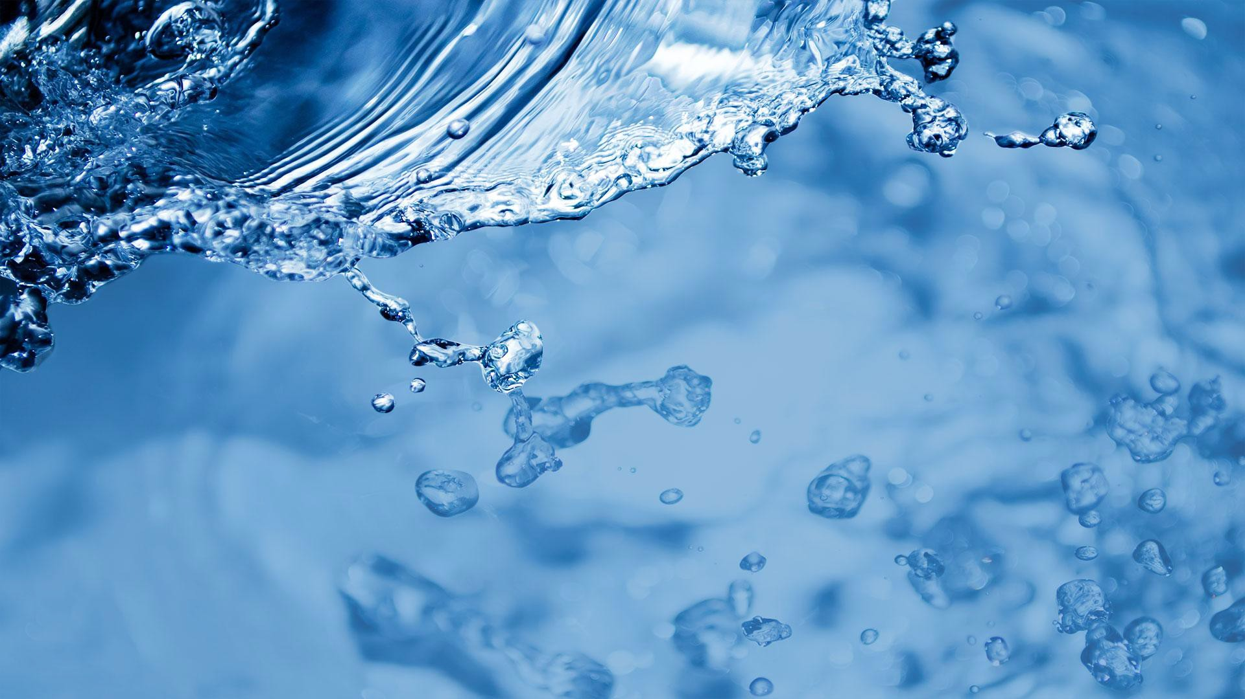


Water Temperature and the National Water Model: Insights from a Physically-based Modeling Approach
Jeffrey Wade, Christa Kelleher, Fred Ogden

Slide 2




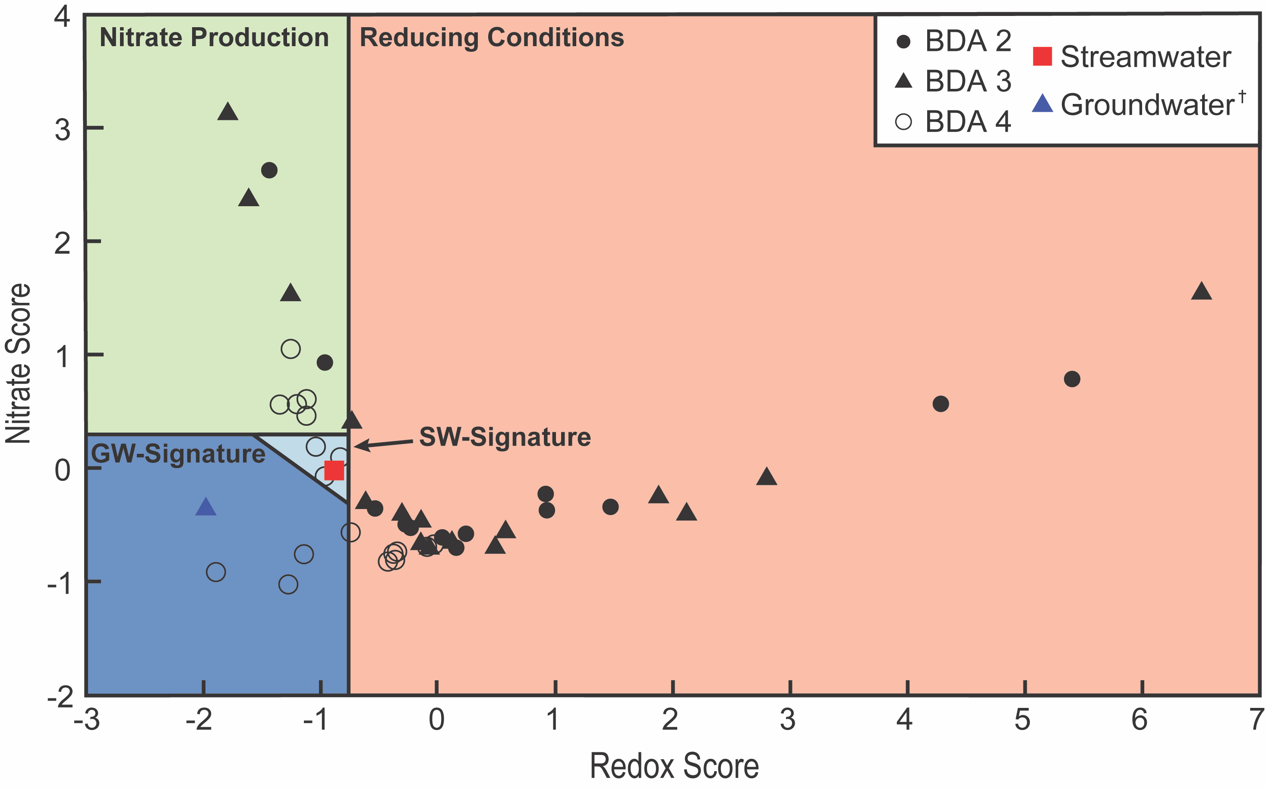
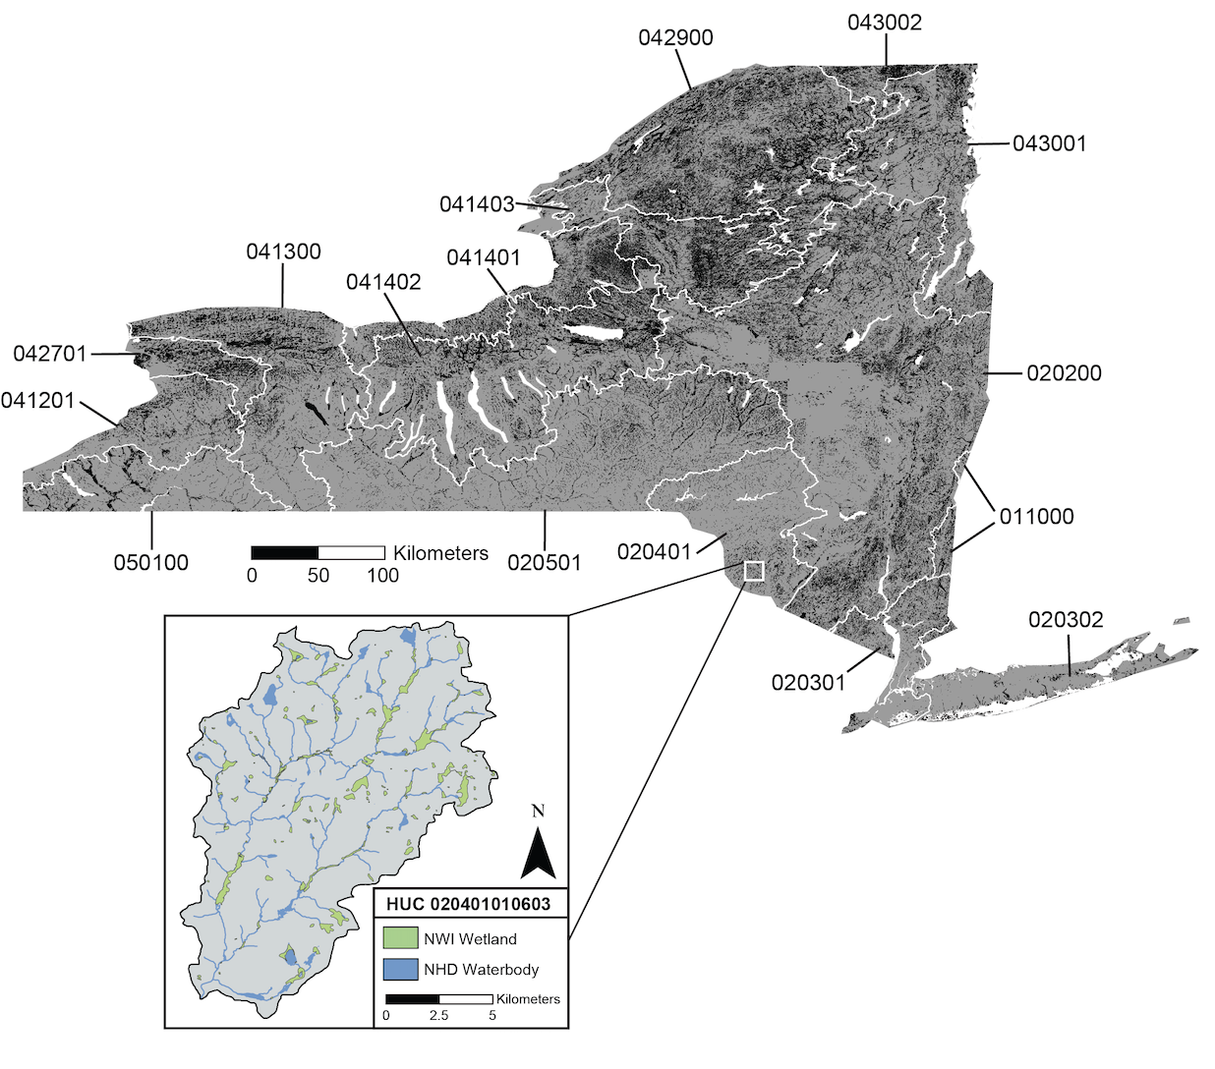
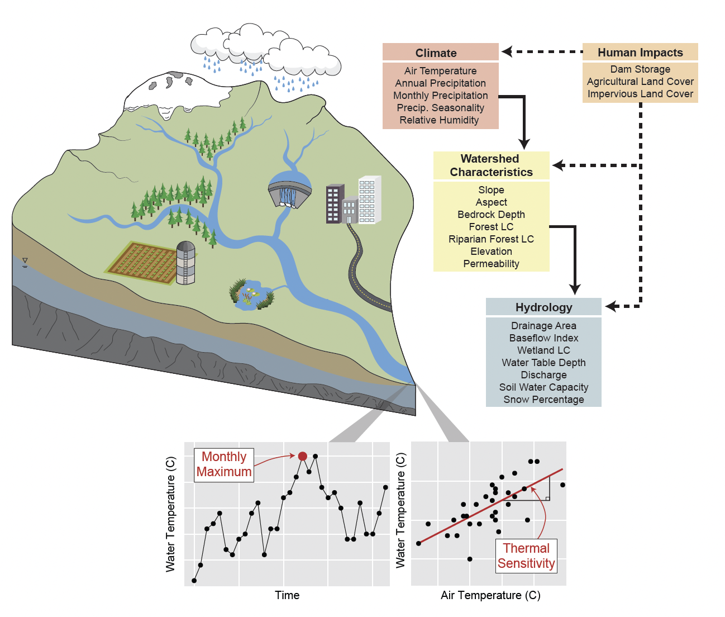
Personal Background
Hyporheic Exchange and
Groundwater-Surface Water Interactions
Wetland and WOTUS
Policy Analysis
River Water Temperature Modeling
(Machine Learning + Mechanistic)
Wade et al., 2020
Wade et al., 2022
Wade et al., in review
2
Notes:
A quick background on myself:
Undergrad in Geology and Geophysics at UW-Madison
Intern Hydrologist at the USGS New England Water Science Center
Nearing completion of PhD in Earth Sciences at Syracuse University (defending in April)
Lapenta Intern
Highlighting a few projects:
Hyporheic exchange and groundwater-surface water interactions around stream restoration structures
GIS-based wetland policy analysis
River temperature modeling, both machine learning and mechanistic modeling

Slide 3
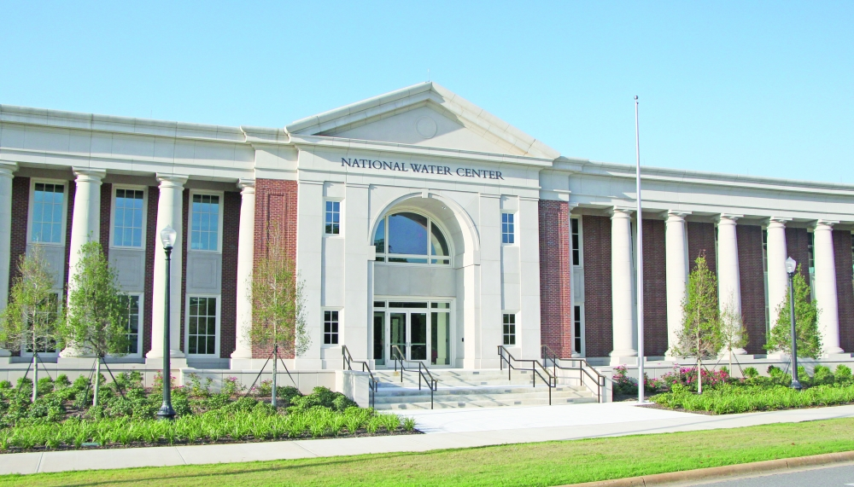
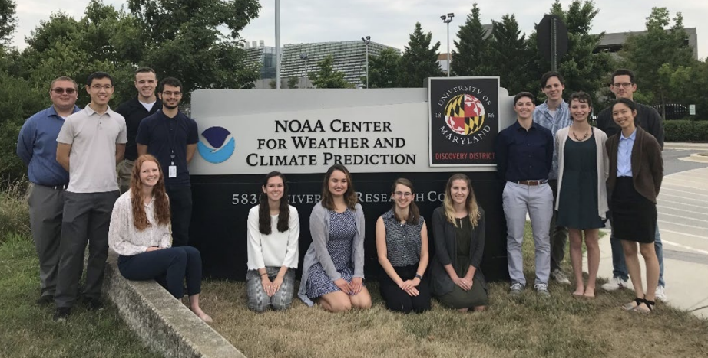
William M. Lapenta Internship
Summer internship program for undergraduate and graduate students at participating NOAA line offices
Independent research + daily seminars with NOAA scientists
NOAA Direct Hire Authority after graduation
Interned at OWP (National Water Center), supervised by Fred Ogden
Tasked with exploring NWM water temperature applications
3
Notes:
William M. Lapenta Internship is a NOAA summer internship program for undergrads and graduate students
Through the internship, students are able to perform independent research and attend daily seminars with NOAA scientists
After completing the program and graduating with their degrees, all interns are Direct Hire eligible
This summer, I was a Lapenta Intern at the Office of Water Prediction/National Water Center, where I was advised by Fred Ogden
There, I was tasked with exploring how water temperature predictions could be incorporated into the National Water Model

Slide 4
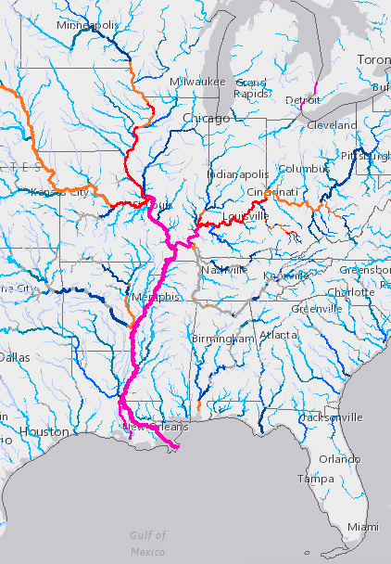
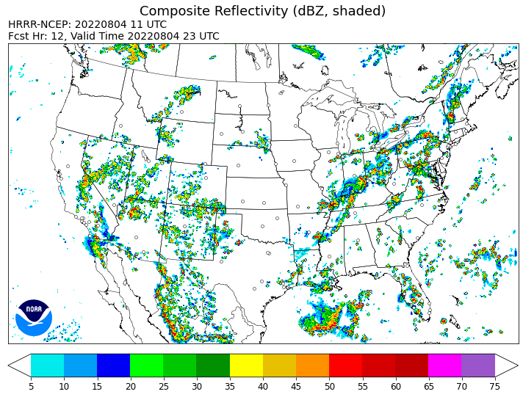
National Water Model: Putting Water on the Map
4
Notes:
I’m sure you all don’t need much of an introduction to WRF-Hydro and the National Water Model, so I’ll move quickly through this intro
The last century has seen major advances in meteorological forecasting and atmospheric models, we can predict with some degree of accuracy storms and extreme events in space and time, alert those in danger with actionable information
However, until recently hydrologists haven’t had comparable tools, flood forecasts were made by NWS River Forecast Centers at specific gages, but forecasts were not spatially continuous
Expansion of forecast capabilities to all US river segments by the National Water Model is a remarkable advancement in the field of hydrology
Can we make similar leaps in prediction for other water quality variables

Slide 5




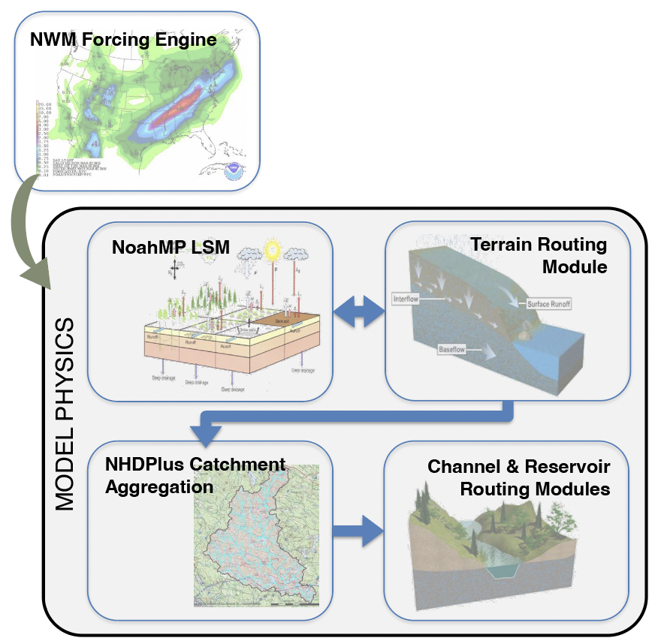
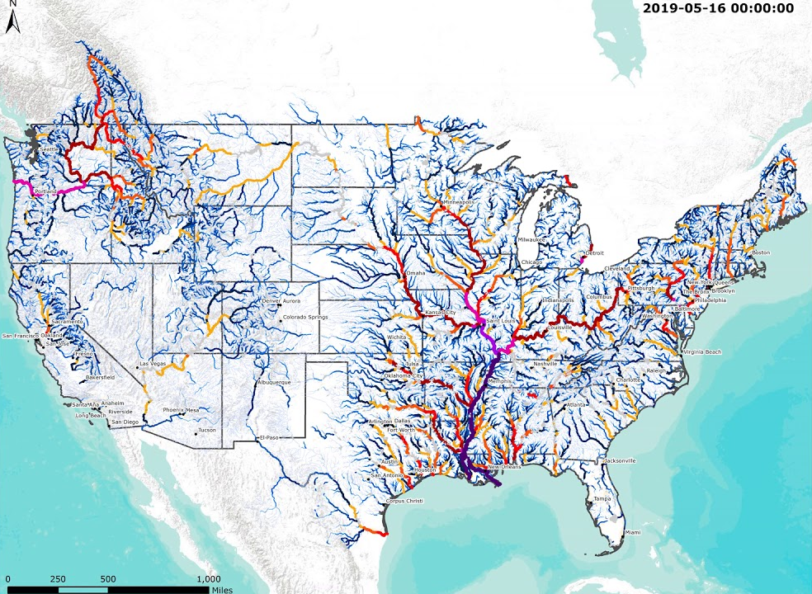
What is the National Water Model?
WRF-Hydro
Model
Configuration
NWM: Real-time and Forecast Streamflow at 2.7 million+ River Reaches
Credit: NCAR (Dave Gochis and Aubrey Dugger)
5
Notes:
NWM is underlain by the WRF-Hydro, an NCAR supported coupled land-atmosphere model that simulates all components of the terrestrial water cycle (Precipitation, snowpack, groundwater).
The NWM is a specific configuration of WRF-Hydro, which uses modeled water fluxes to route streamflow through each of the US’s 2.7 million river reach segments mapped by the National Hydrography Dataset

Slide 6





Temperature: A ‘Master’ Water Quality Variable
“Conduct exploratory efforts for water quality prediction, including water temperature modeling, in partnership with the NOAA/National Marine Fisheries Service (NMFS) and other collaborators.”
“Leverage the NextGen NWM to deliver initial water quality prediction capabilities for water temperature”
OWP Strategic Plan 2021-2026
6
Notes:
If we look at OWP’s 5 year strategic plan, it calls for exploratory efforts in modeling water quality, including water temperature
Why does NOAA have an interest in water temperatures?
Now when you hear the term water quality, you might not initially think of water temperature as falling into that category
However, water temperature is often considered a master water quality variable, as it directly controls most aspects of water quality
Dissolved oxygen, higher temps = lower dissolved oxygen
Controls rates of microbial processing of other solutes
Cold-water Fish and fishery health is closely linked to water temperature (salmon, trout)
Power production: River water is used to cool power plants, warmer waters = less efficient power production

Slide 7
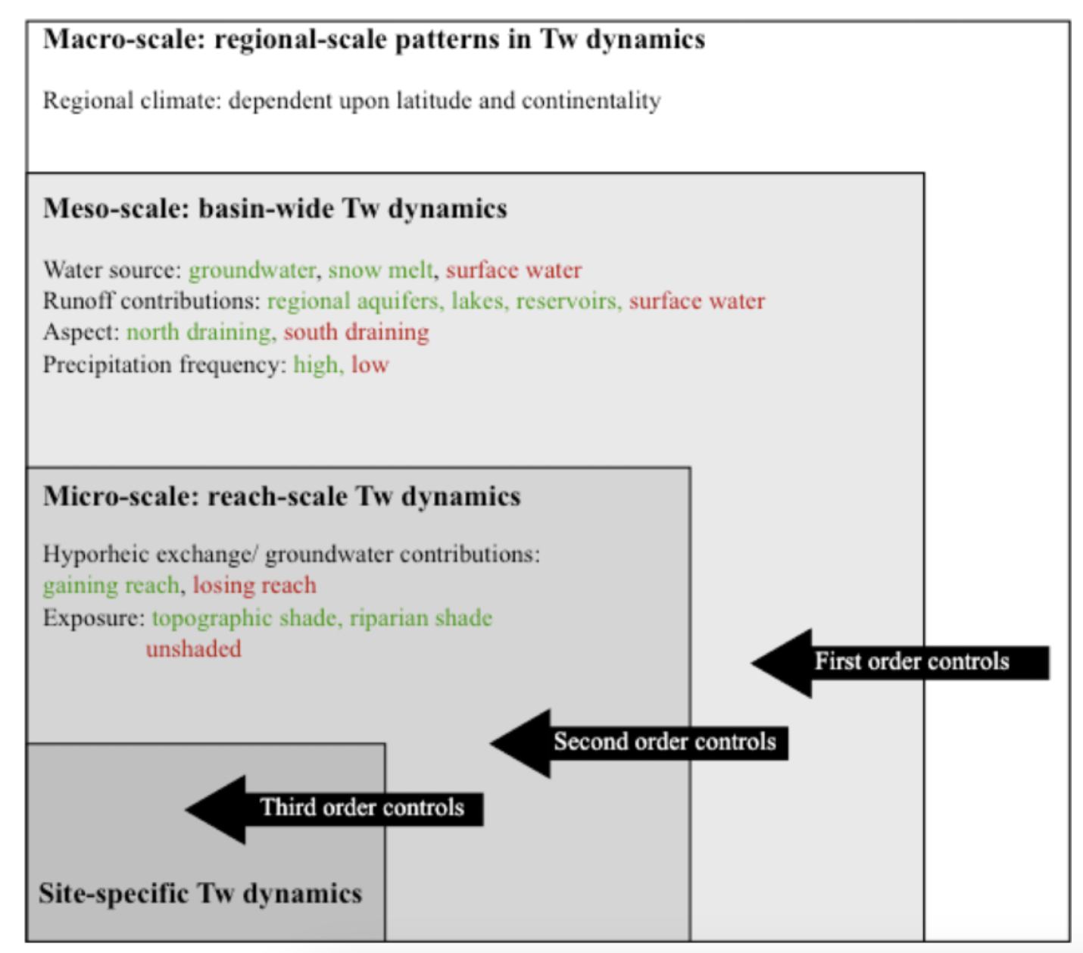
Approaches to Water Temperature Modeling
Modeling Frameworks
Statistical Models
Physically-based Models
Temperature Controls
Rely on statistical relationships between water temperature and environmental variables (ex: linear regression, machine learning)
Explicitly quantify heat fluxes at the air-water and water-bed interfaces, transporting heat downstream
Hannah & Garner (2015)
7
Notes:
A quick background on water temperature modeling approaches
Water temperatures are controlled by micro-, meso-, and macro-scale drivers: water sourcing, stream configuration, shading, climate
Two general ways to incorporate an understanding of these drivers into water temperature models
Statistical Models
Physically–based models
Statistical Models (linear regression, machine learning, others) rely on statistic relationships between temperatures and other environmental variables
Physically-based Models explicitly quantify fluxes at the air-water and water-bed interfaces, transporting heat downstream.
Physically-based models are ideal for predicting in ungaged areas, and forecasting into future time periods
Both have a multitude of applications in the literature. My work focuses on applying physically-based water temperature models to the NWM.

Slide 8
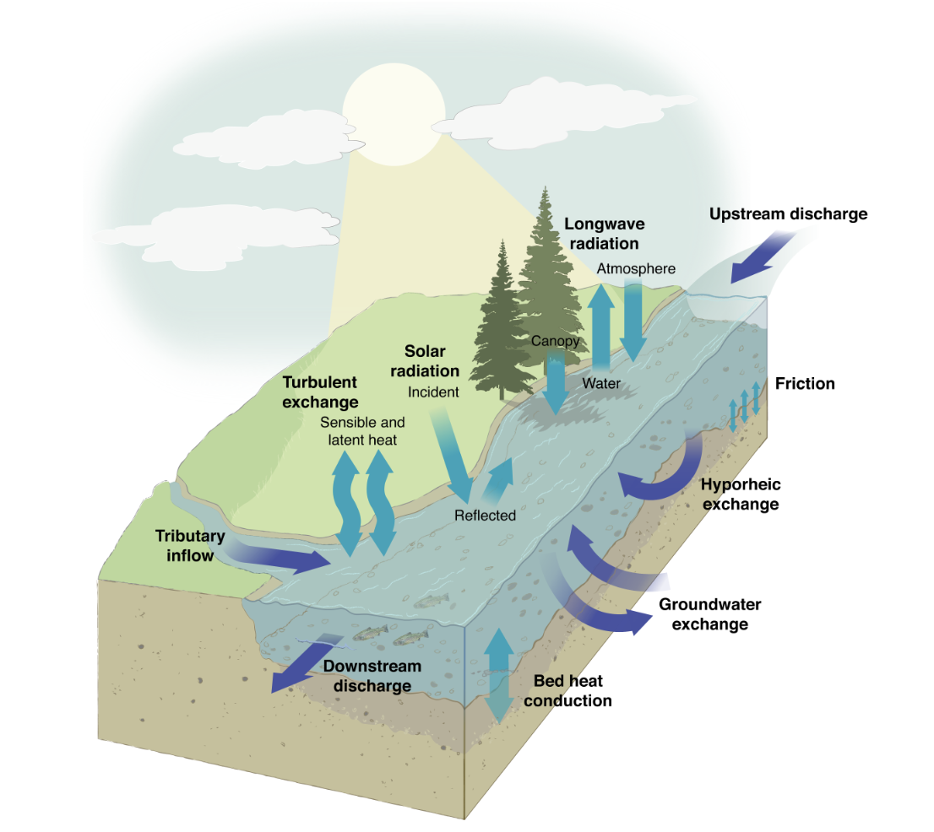
Physically-based Water Temperature Modeling
Physically-based Models
Explicitly quantify heat fluxes at the air-water and water-bed interfaces, transporting heat downstream
Leach et al. (2023)
8
Notes:
Physically-based models of water temperature are ultimately based on heat fluxes into and out of the stream
Air-water Interface: dominated by net radiation
Solar radiation (influenced by riparian shading)
Incoming and outgoing longwave radiation
Also turbulent fluxes: sensible and latent heat exchange
Water-Bed Interface: dominated by hydrologic fluxes
Groundwater exchange
Hyporheic exchange
Bed conduction (contact between bed and water)
Physically-based water temperature models function in reference to an upstream boundary condition.
They use the net heat flux into the stream, the current water temperature, and the volume of water to simulate incremental changes in temperature
Therefore, In order to correctly predict temperatures, we must correctly quantify each of these fluxes

Slide 9
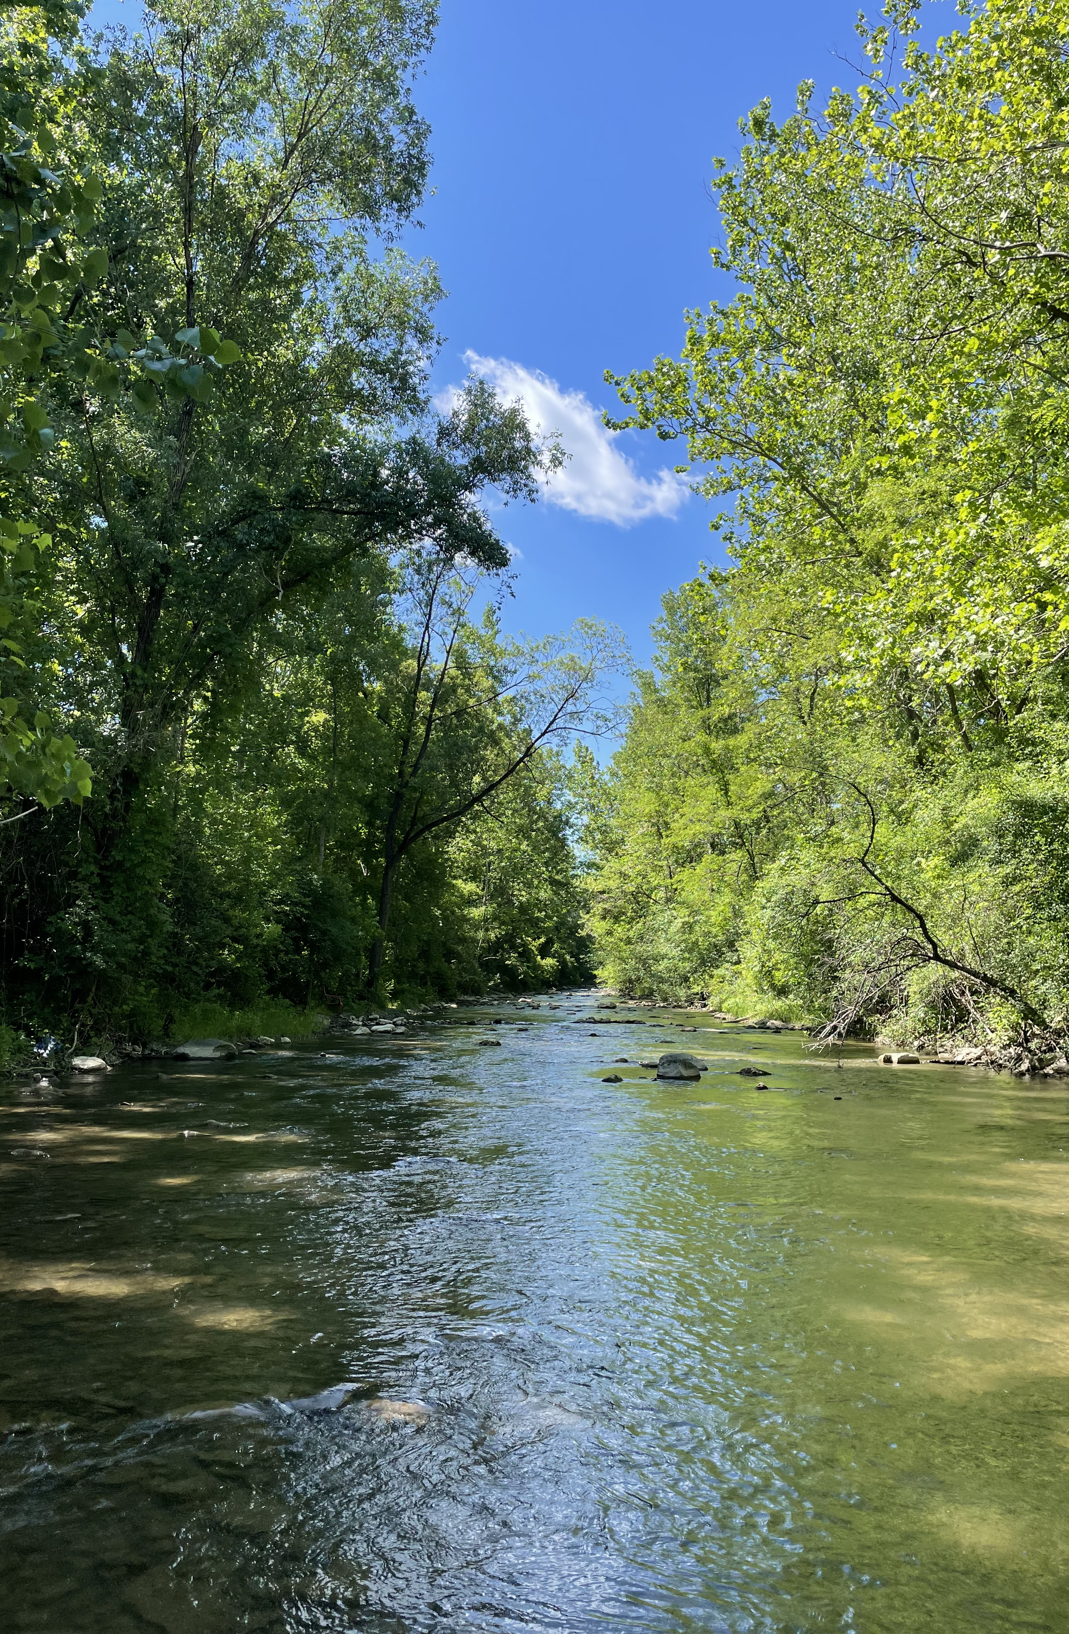

OWP Goal: Develop models to predict water temperature at 2.7 million river reaches using the Nextgen Model Framework
My Goal: Demonstrate viability of a water temperature model along a test reach using NWM forcings and outputs.
Can water temperature be accurately predicted from NWM data?
What gaps/deficiencies in NWM data exist for application to WT prediction?
9

Slide 10
Big Caveats…What This Isn’t
This was not intended to be operational: Only to explore how NWM data could be incorporated into a WT model.
Lack of computing resources (and time): Only tested in a single catchment over 1 month of summer baseflow.
10
Notes:
I want to mention a few caveats before I get into my research
This work was a proof-of-concept and not intended to be immediately operational. There’s still lots of progress to be made.
A lack of computing resources and time limited the scale of this work. The models I’ll present today are only in a single catchment over a single month period
All this is to say, this work is still in it’s early days and has a long way to go before it can be incorporated into NOAA products.

Slide 11
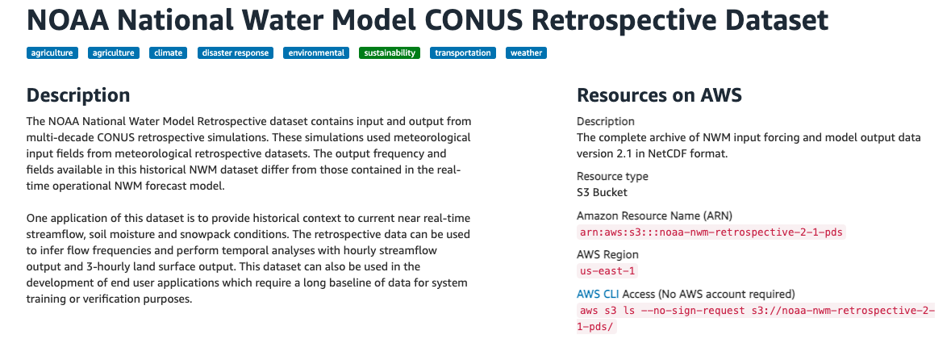
NWM Retrospective V2.1
42-year historical run of NWM V2.1, forced by Analysis of Record for Calibration (AORC)
Publicly available and commonly used when evaluating the performance of the NWM
11
Notes:
The models I will present are based on data from the National Water Model v2.1 Retrospective runs.
I’m sure you’re all familiar with the Retrospective but if not, it’s a 42-year historical run of the NWM v2.1, forced by the Analysis of Record for Calibration dataset
I chose to use the Retrospective because it is publicly available on AWS and commonly used in studies evaluating NWM performance.
Easier to align with historical observations of water temperatures than real-time NWM runs

Slide 12
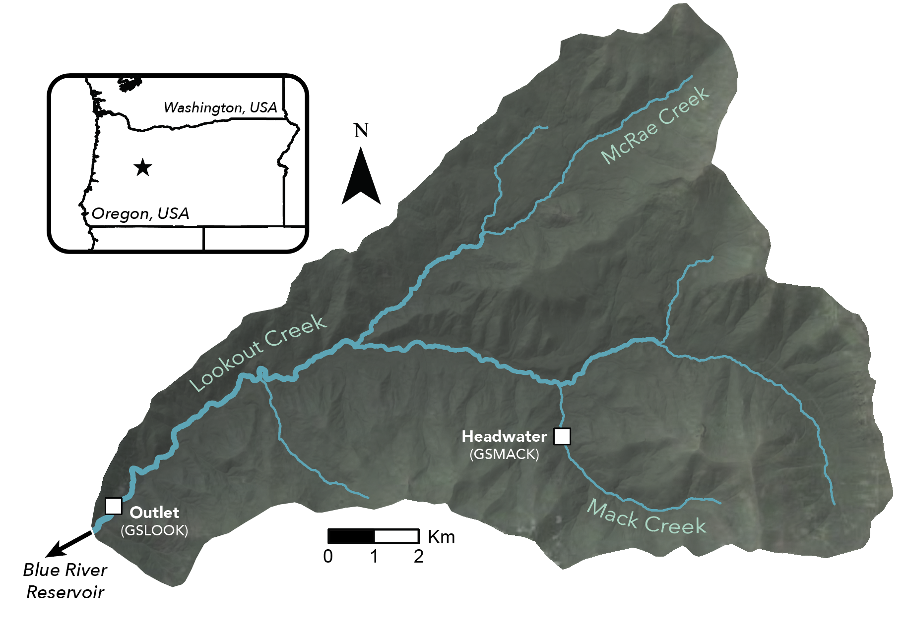
Test Basin: H.J. Andrews Experimental Forest
64 km² forested headwater catchment draining the Cascade Mountains, OR
Location of an NSF Long Term Ecological Research (LTER) site
2 water temperature gages coincided with NWM reaches (Headwater, Outlet)
12
Notes:
Developing a WT model – a test basin is needed, not practical to run model on continental-scale domains
I considered several test basins: criteria: limited number of tributaries (straightforward to model), as many USGS temperature gages as possible, particularly in headwaters (enables model evaluation)
Settled on modeling temperatures in H.J. Andrews Experimental Forest, which I’m sure some of you are familiar with
HJ Andrews is a 64 km2 forested headwater catchment in the Cascade Mountains of Oregon,
Roughly 35 km of rivers represented by the NWM
Site of an NSF LTER
2 water temperature gages coincided with NWM reaches, providing headwater and outlet evaluation points

Slide 13
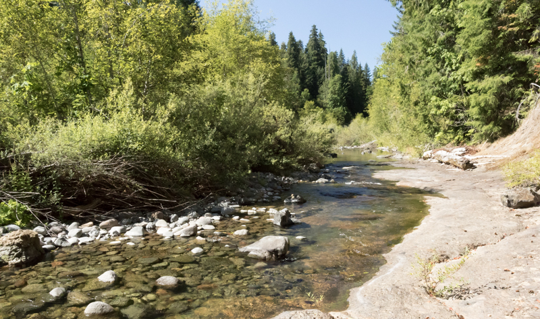
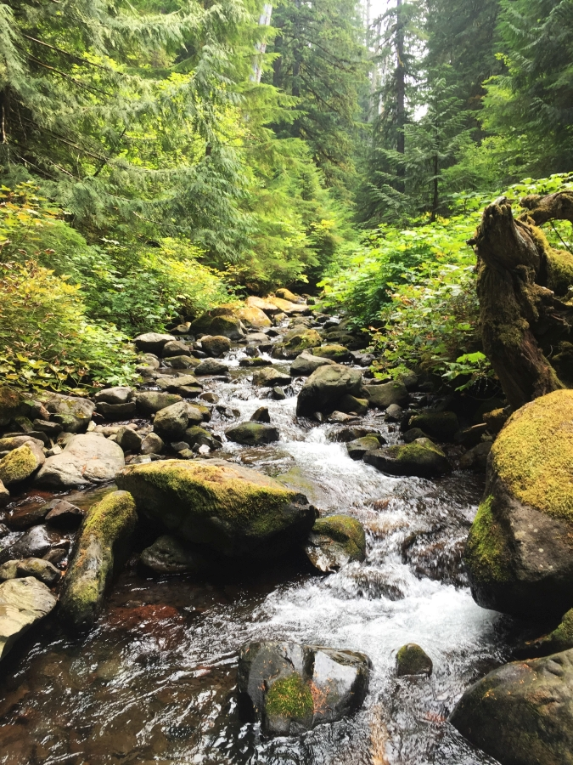
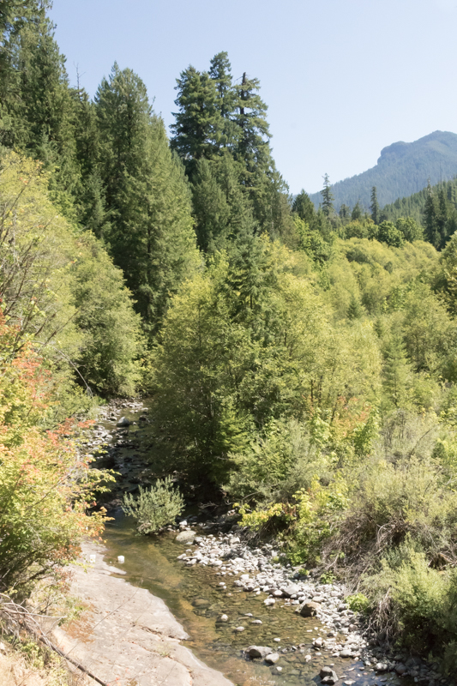
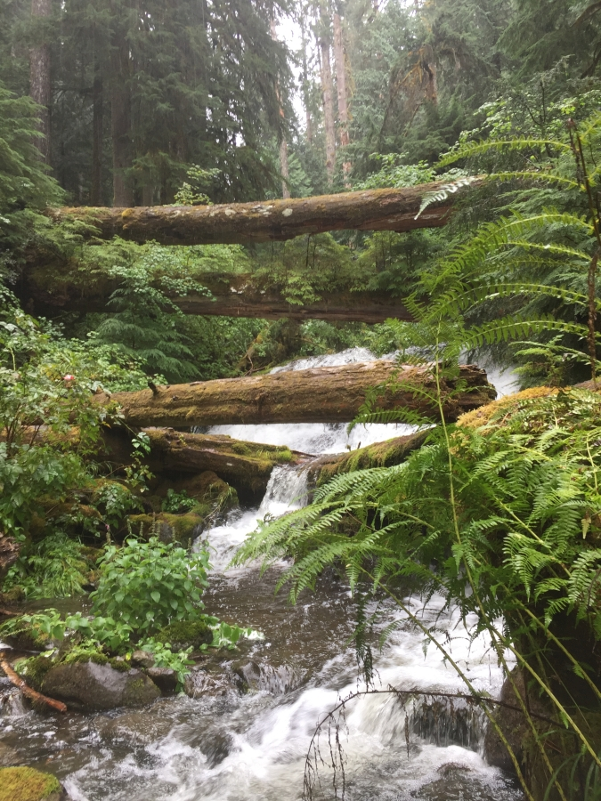
H.J. Andrews Experimental Forest
Photo Credit: Lina DiGregorio
13
Notes:
Some images from the H.J Andrews watershed
There are likely some incredibly complex hydrologic and thermal processes at work here
Might be one of the more difficult settings to predict water temperatures
Hydrologic heat fluxes and shading will be strong controls on water temperatures

Slide 14
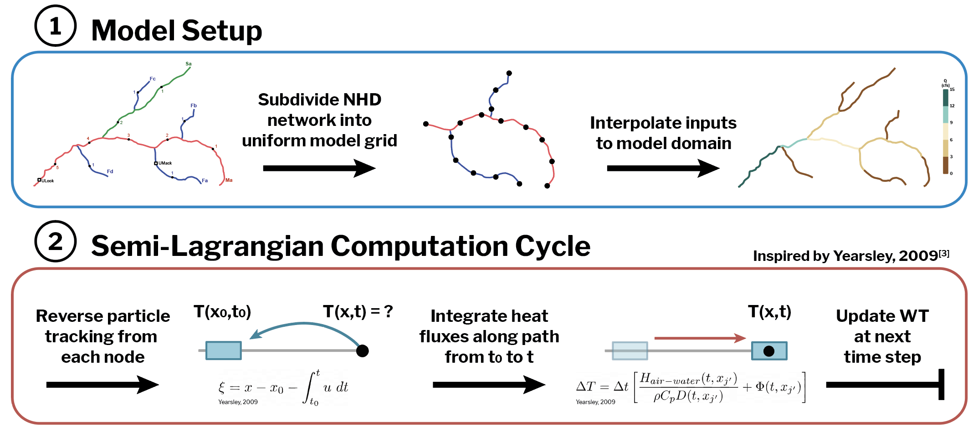
Water Temperature Model Formulation
Inspired by Yearsley, 2009 (DHSVM-RBM)
Resolution: 1 km model reaches, 60 minute time step (both adaptable)
1 month of data during low-flow conditions: July 2019
14
Notes:
First step: take initial river reaches from the NWM and subdivide them into a manageable and uniform model grid,
Then take all of our model inputs, which I’ll talk more about in a minute, and interpolate them to our new model domain
Should note that the uniform model grid is not necessary and this approach could work directly on the NWM reaches themselves
I used a model grid because it gave me better ability to diagnose model error at specific points in the stream network
Then, set up the computation scheme: I used a Semi-Lagrangian Computation Cycle, inspired by the work of John Yearsly, 2009 (similar to what is used in DHSVM-RBM, another water temperature model)
1 dimensional advection model: heat is transported longitudinally along the stream, and heated or cooled by atmospheric and hydrologic heat fluxes
Semi-Lagrangian refers to the model frame of reference – half Eulerian-half Lagrangian
We want to find the temperature at each of our model grid points using our model boundary conditions – use Reverse Particle Tracking
Start at a node point with unknown temperature and and flag the water parcel located there.
Then reverse one time step, and use river velocity to find the original starting location of the water parcel that ends up at our unknown grid point at the current time step (blue box)
Then, we follow our water parcel as it travels back downstream to our unknown node, calculating and integrating radiative and hydrologic inputs that we accumulate along the way
Using the volume of the node and the heat fluxes, we can update the unknown temperature at the next time step
I ran the model at a 1 km spatial resolution and a 60 minute time step, though both those choices are easily adaptable and stable
Ran the model during July 2019, 1 month of data during low-flow conditions

Slide 15
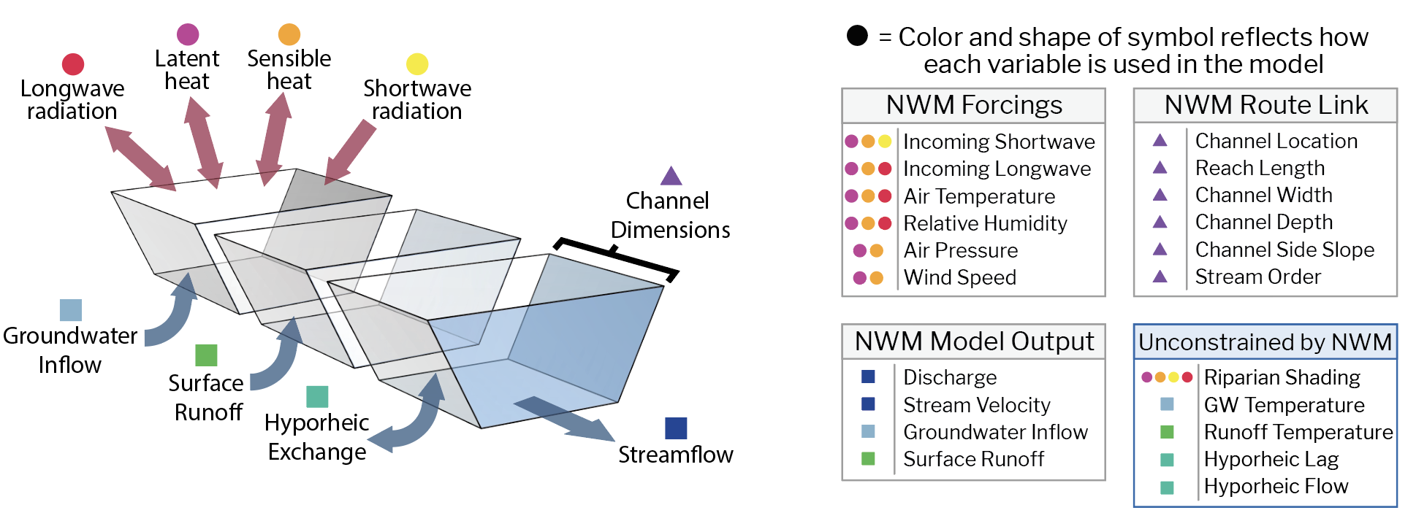
Translating NWM into Temperature Model Inputs
15
Notes:
Now a key part of our modeling strategy is quantifying heat fluxes into and out of the stream network
To do this, I used forcings and model outputs from the NWM retrospective, alongside a number of physically-based equations, to calculate a range of heat fluxes
This figure displays all heat fluxes incorporated in our model (air-water fluxes on top, water-bed fluxes on the bottom). I should note that we don’t represent bed conduction fluxes in this model, as they would be very difficult to constrain at the scale of the model.
The points on the right show the NWM variables used, their source, and which heat fluxes they contribute to.
For example: air temperature contributes to calculations of longwave radiation, latent heat, and sensible heat
From the NWM forcing files, I used shortwave, longwave, air temp, humidity, air pressure, and windspeed.
From NWM model outputs, I used discharge, stream velocity, groundwater inflow, and surface runoff.
From NWM route link file, I used several parameters describing the configuration of channels
Notably, several needed variables are absent from NWM data (next slide)

Slide 16
Variables Unconstrained by the NWM
Riparian Shading
We needed to
develop strategies to tune or estimate each of these processes.
Groundwater Temperatures
Hyporheic Exchange
Surface Runoff Temperatures
16
Notes:
As noted on the last slide, there are 4 primary variables that are unconstrained by the NWM:
Riparian shading along channels (important control on water temperature, blocking solar radiation from reaching the stream’s surface)
Groundwater temperatures (controls advective heat flux to streams)
Hyporheic exchange (influential in high relief headwaters, we found that representing hyporheic flow improved model performance)
Surface runoff temperatures (likely important during storm events, but there was little to no surface runoff during July 2019 in the basin, so we generally disregarded runoff temps)
We needed to develop strategies to estimate these processes.

Slide 17

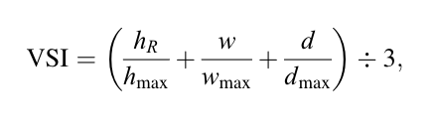
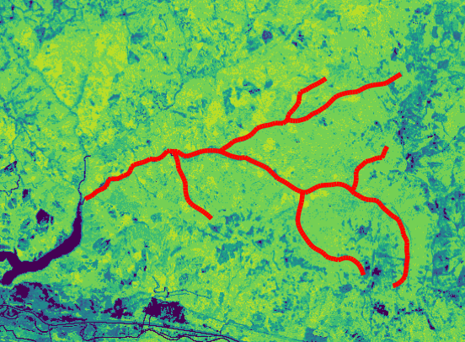
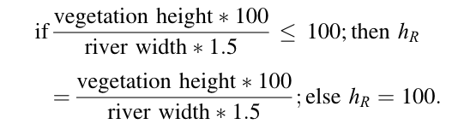
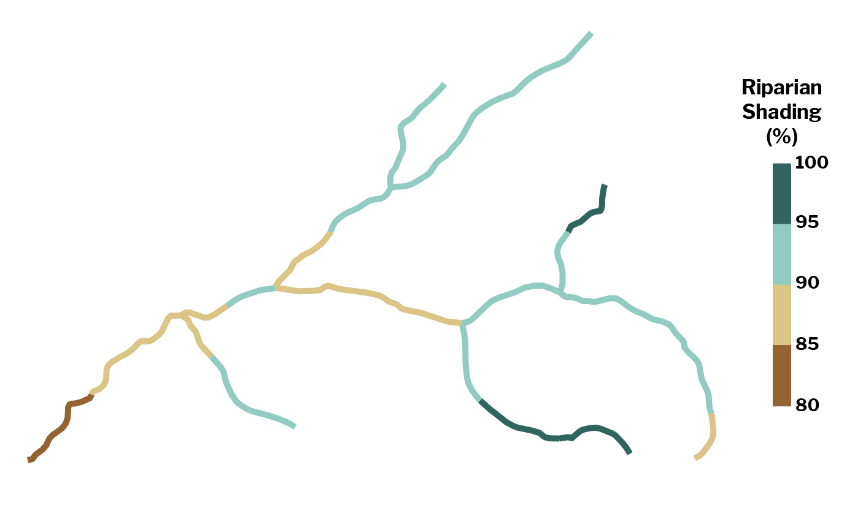
Deriving Riparian Cover from Gridded Datasets
USFS LANDFIRE
30-m Canopy Products
Vegetation-Shading Index
Kalny et al. (2017)
Reach-specific
Riparian Shading
Vegetation Height
Canopy Cover
Accounts for vegetation height, buffer width, stream width, canopy cover, sun angle, and stream aspect
17
Notes:
One missing variable from the NWM is riparian cover, we had to devise a strategy to estimate riparian shading
Riparian shading is important in a stream temperature model because it moderates the amount of incoming solar radiation, which makes up a large proportion of the energy balance
Riparian shading is difficult to characterize at high resolution at all reaches
We used US Forest Service 30-m canopy products and a vegetation shading algorithm to estimate shading.
This approach, from Kalny et al., 2017, accounts for vegetation height, buffer width, canopy cover, sun angle, and stream aspect
Using this approach, we translated gridded vegetation height and canopy cover to reach-specific estimates of riparian shading

Slide 18
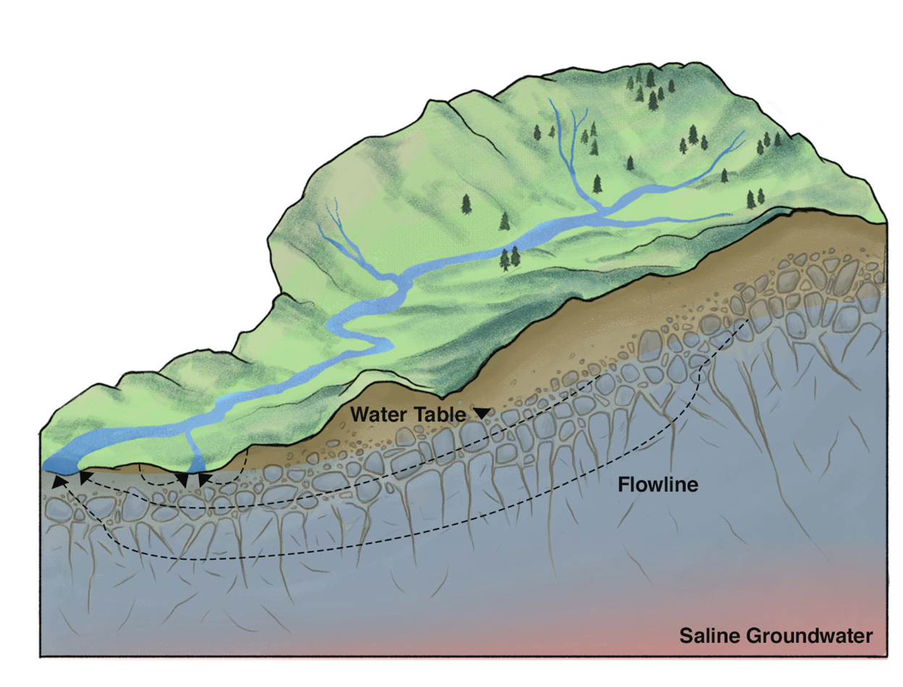
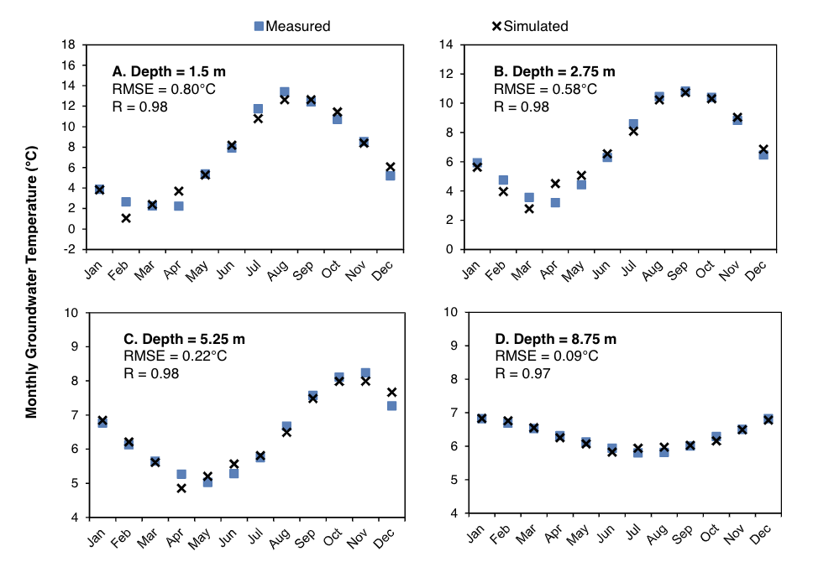
What is the Temperature of Groundwater?
Or more specifically, what is the temperature of groundwater when it enters the stream?
T_{GW} ~ More Variable
Condon et al. (2020)
Kurylyk et al. (2013)
T_{GW} ~ Annual Air Temperature
18
Notes:
Another unknown is the temperature of groundwater inflow to streams, a strong control on the temperature of headwater streams
More specifically, what is the temperature of groundwater when it enters the stream?
In our model, this was particularly important because we used groundwater inflow temperature to define the upstream boundary condition
Groundwater temperature is often defined as annual air temperature, but that’s actually the temperature of deep groundwater
The temperature of shallow groundwater is much more variable and often warmer in summer months
We found that our approach to estimating groundwater temperatures must incorporate temporal variations

Slide 19
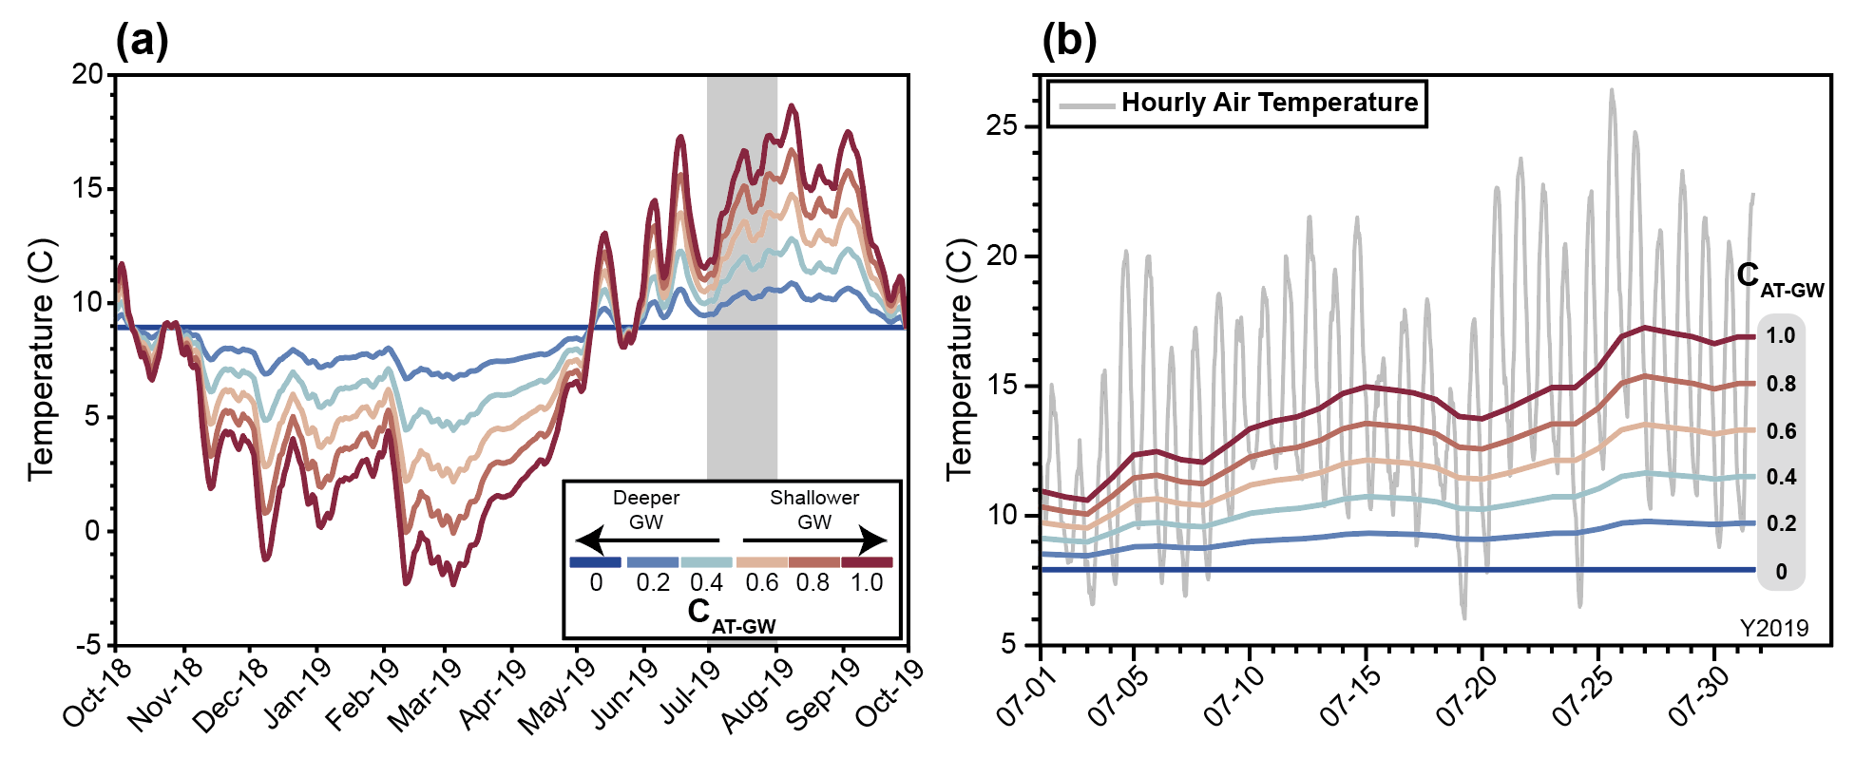

Calibrated Approach to Inflow Temperatures
Requirements: Must be temporally variable and tunable to calibrate model
Solution: Smooth and damp air temperatures using calibrated parameter
$${WT}_{Inflow}=C_{AT−GW}∗\left({AT}_{D}− \overline{AT}\right)+\overline{AT}$$
AT_{D}
Condon et al. (2020)
$$\overline{AT}$$
19
Notes:
Requirements: GW Temp must be temporally variable and tunable to calibrate the model
Our solution relies on the fact that inflow temperatures are likely bounded by the ground surface temperature and the temperature of deep groundwater.
We smoothed and damped air temperatures using calibrated parameters to adjust temperatures between those two bounds using the formula here.
By adjusting the C term in this equation, we can control the effective source depth of inflows and therefore the magnitude and variability of temperatures
We allowed C to vary by stream order (third order network), so down-valley reaches could have different effective source depths
Full year of GW temperatures: red (shallow sourcing), blue (deep sourcing). Obviously this wouldn’t work in winter, but it does work fairly well in summer
During the July study period, range of GW temperatures given calibration parameters

Slide 20
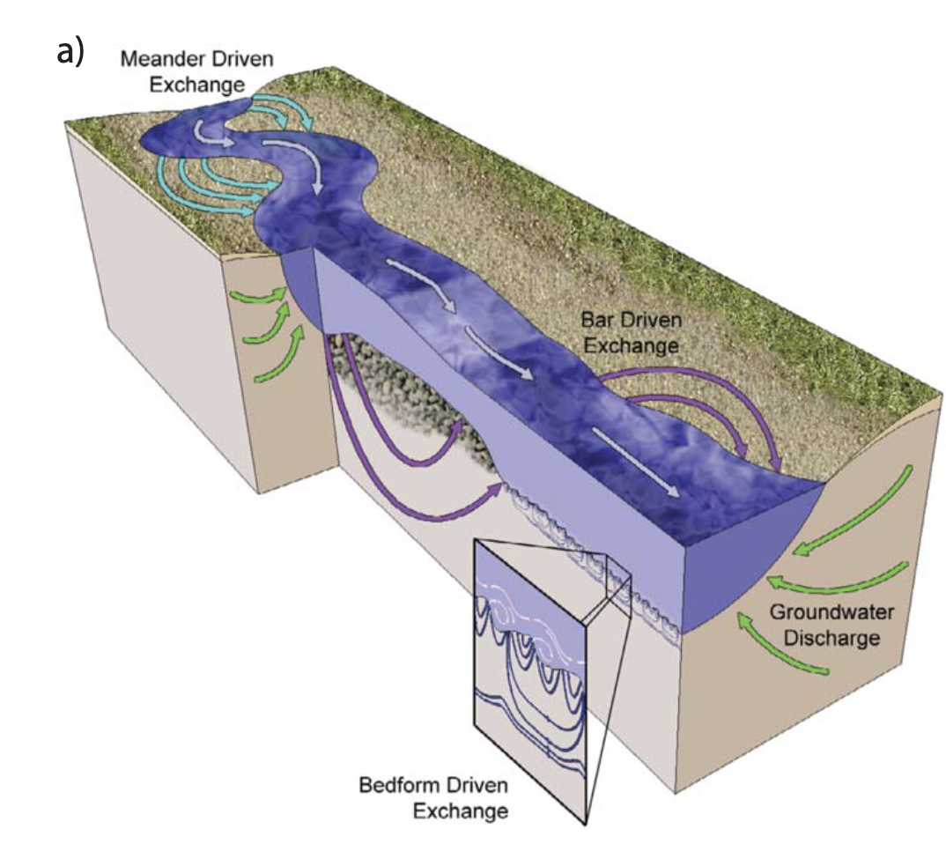
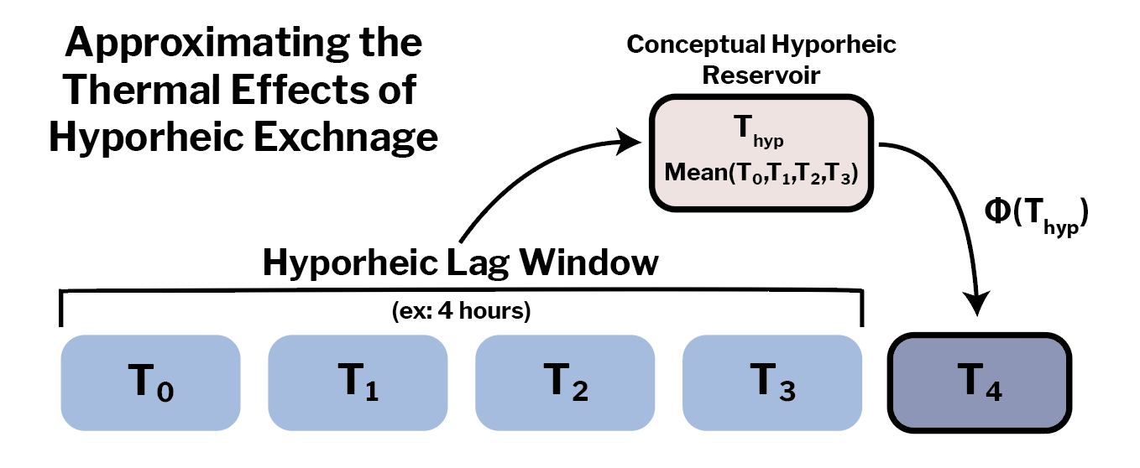
Incorporating a Conceptual Hyporheic Zone
Our approach simulates the thermal effects of hyporheic exchange using tuned parameters controlling lag time and inflow rate that vary by stream order.
In summer, this narrows the diel range, providing a cooling daytime effect and a warming nighttime effect.
Cardenas (2015)
20
Notes:
Hyporheic exchange can be influential to water temperatures in low-order streams and we found a lagged heat component was needed to fit temperatures
Hyporheic flow occurs when water enters the streambed and returns back to the channel at a later time.
In summer, hyporheic flow typically has a damping effect on water temperatures, reducing maxima and increasing minima
Our approach to hyporheic exchange only seeks to approximate the thermal effects of hyporheic exchange, rather than resolve mass transfer
We simulate these effects using a conceptual hyporheic reservoir, which stores water from previous time steps and returns it to the stream at a lagged time later.
We control the flow and timing of hyporheic exchange by tuning parameters related to lag time and inflow rate, independently by stream order (1st order streams can have different exchange rate than higher order streams)

Slide 21
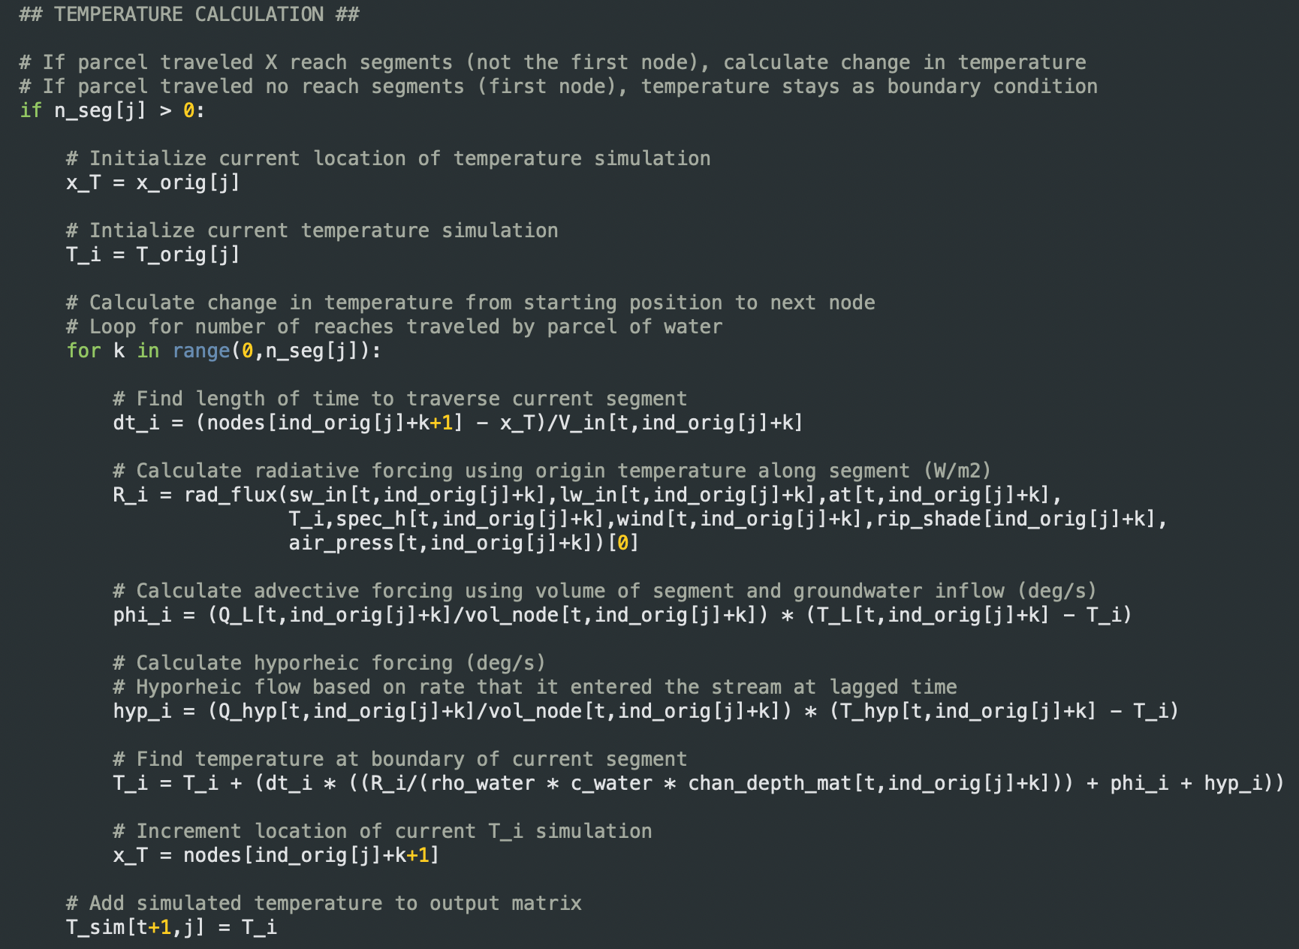
Python-based Model Scripts (Soon to be on GitHub!)
NWM Retrospective Data AWS Download
Riparian Shading Data and Calculations
Water Temperature Model (v20!)
Model Runs, Monte Carlo, and Error Calculation
Data Visualization
21
Notes:
All this modeling was performed in Python, scripts are soon to be up on GitHub

Slide 22
Model Configurations as Hypotheses for Processes
Sequentially add complexity to model configurations, reflecting uncertainty in unknown inputs
M1
M2
M3
M4
Variable Groundwater
Temperature
Variable Groundwater
Temperature
Variable Groundwater
Temperature
Variable Groundwater
Temperature
Riparian Shading
Riparian Shading
Riparian Shading
Riparian Shading
Variable Groundwater
Inflow
Hyporheic Exchange
Variable Groundwater
Inflow
Hyporheic Exchange
Increasing Parameterization
Additional Processes Represented
22
Notes:
Model configurations represent hypotheses for how we conceptualize hydrologic and thermal behavior in the basin
By sequentially adding complexity to model configurations, we can try to balance tradeoffs between performance, efficiency, and the risks of overparameterization
I’m going to present model results from four different configurations of the water temperature model (M1 through M4). Each of these configurations add additional tuning parameters to represent physical processes and uncertainty
M1: simplest model, only varies groundwater temperature, riparian shading
M2: adds variable groundwater inflow
M3: Instead of groundwater inflow, adds conceptual hyporheic zone
M4: All possible tuning parameters, GW temperature, GW flow, riparian shading, hyporheic exchange

Slide 23
Model Calibration Through Monte Carlo Tuning
5,000 model runs for each configuration using random uniform Monte Carlo sampling
Each run takes ~15 seconds for 1 month (on a Mac)
Notation | Parameter | Units | Calibration Range | Model
C¹_{AT-GW} | AT-GW coefficient (first-order) | unitless | 0 - 1 | M1, M2, M3, M4
C²_{AT-GW} | AT-GW coefficient (second-order) | unitless | 0 - 1 | M1, M2, M3, M4
C³_{AT-GW} | AT-GW coefficient (third-order) | unitless | 0 - 1 | M1, M2, M3, M4
W | Air temperature moving window duration | days | 2 - 14 | M1, M2, M3, M4
R_{shade} | Riparian shading coefficient | unitless | 0.5 - 2 | M1, M2, M3, M4
GW¹ | Groundwater inflow rate coefficient (first-order) | unitless | 0.5 - 2 | M2, M4
GW² | Groundwater inflow rate coefficient (second-order) | unitless | 0.5 - 2 | M2, M4
GW³ | Groundwater inflow rate coefficient (third-order) | unitless | 0.5 - 2 | M2, M4
H_{lag} | Hyporheic lag duration | hours | 2 - 24 | M3, M4
H¹_{frac} | Hyporheic flow fraction (first-order) | unitless | 0 - 1 | M3, M4
H²_{frac} | Hyporheic flow fraction (second-order) | unitless | 0 - 1 | M3, M4
H³_{frac} | Hyporheic flow fraction (third-order) | unitless | 0 - 1 | M3, M4
Model | Tuned Parameters | Parameter Number
M1 | C¹_{AT-GW}, C²_{AT-GW}, C³_{AT-GW}, W, R_{shade} | 5
M2 | C¹_{AT-GW}, C²_{AT-GW}, C³_{AT-GW}, W, R_{shade}, GW¹, GW², GW³ | 8
M3 | C¹_{AT-GW}, C²_{AT-GW}, C³_{AT-GW}, W, R_{shade}, H_{lag}, H¹_{frac}, H²_{frac}, H³_{frac} | 9
M4 | C¹_{AT-GW}, C²_{AT-GW}, C³_{AT-GW}, W, R_{shade}, GW¹, GW², GW³, H_{lag}, H¹_{frac}, H²_{frac}, H³_{frac} | 12
23
Notes:
We tuned each model configuration using uniform Monte Carlo sampling of parameter ranges. Each configuration as run 5000 times, which each run taking roughly 15 seconds
With this tuning approach, our aim was to determine if there was any combination of parameters that could calibrate the model. Not focused on mean performance of the model at this point
Some parameters were tuned independently by stream order, meaning that different sized reaches could be tuned differently.
Parameter numbers ranged from 5 degrees of freedom (M1) to 12 degrees of freedom (M4)
Parameter ranges were intentionally wide to capture full range of possible behavior, this combined with random sampling, resulted in many poor model runs.

Slide 24
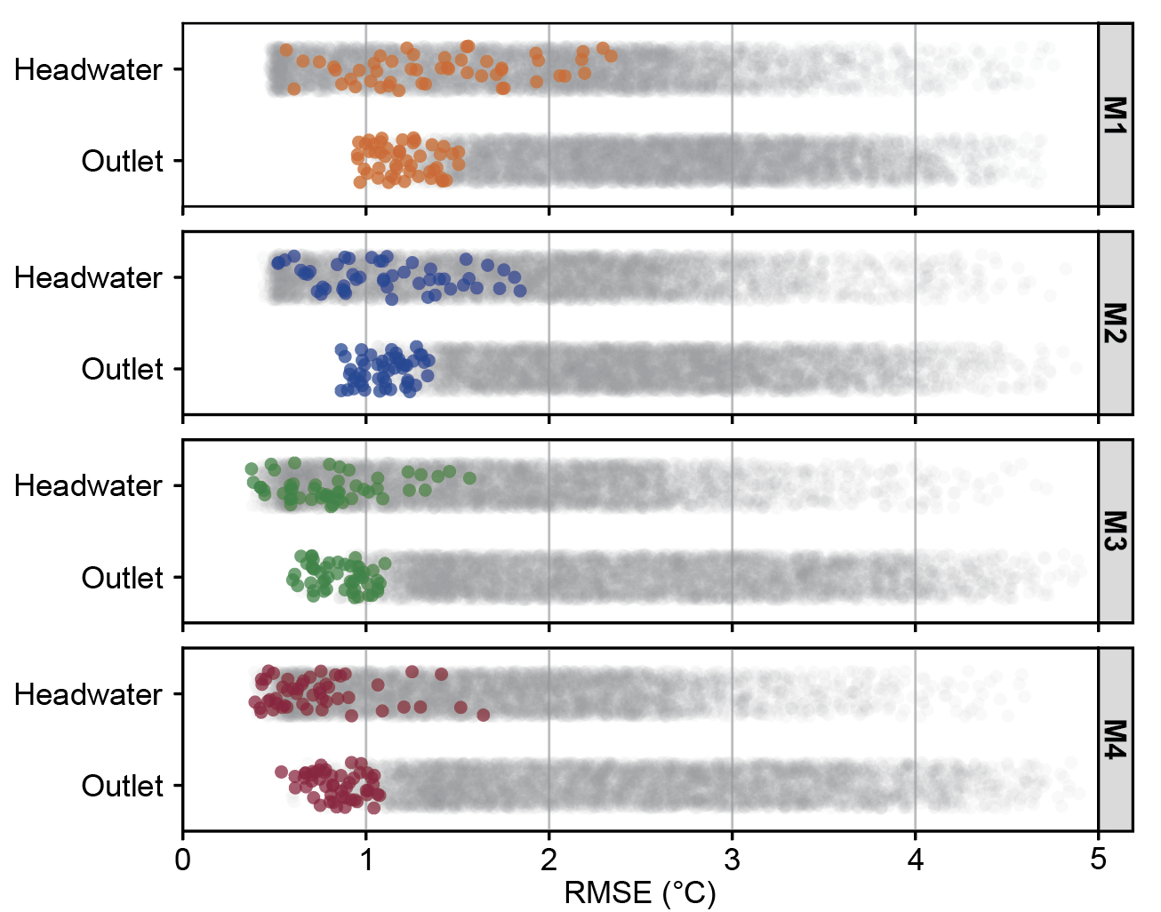
Evaluating Peak Potential Model Performance
Selected top 1% of runs (50 runs) by weighted RMSE (colored points), prioritizing fit at the outlet.
We assumed these runs represented peak performance of configuration when well-calibrated.
24
Notes:
Our tuning approach was not designed to produce good mean model behavior. Instead we chose to focus on the peak potential of each configuration to evaluate the best case for model performance
We did this by selecting the top 1% of runs for each configuration by weighted RMSE of the two gages in the basin, prioritizing fit at the outlet.
We did this because we generally expect uncertainty in temperatures to decrease downstream, which I’ll talk about a bit later
We assumed these runs represented the peak performance of each configuration when well-calibrated. The rest of the results are for these top 50 runs.
The plot on the right shows the error in the top 1% of runs for the headwater and outlet gages. We can see that there is a high degree spread of RMSE across all runs, but top runs are often clustered below 1 C RMSE.

Slide 25
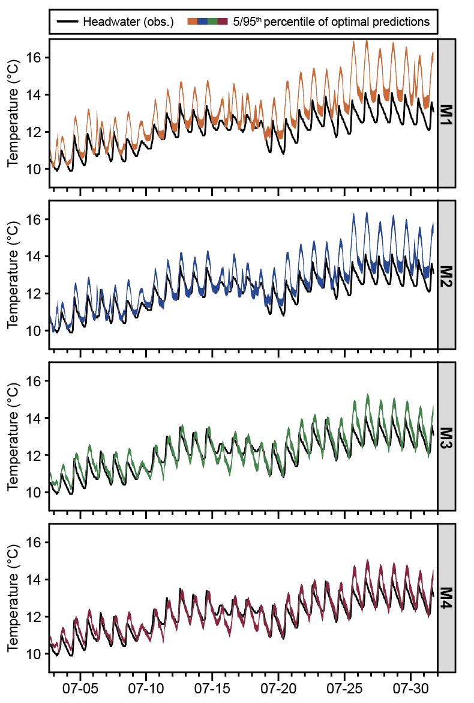
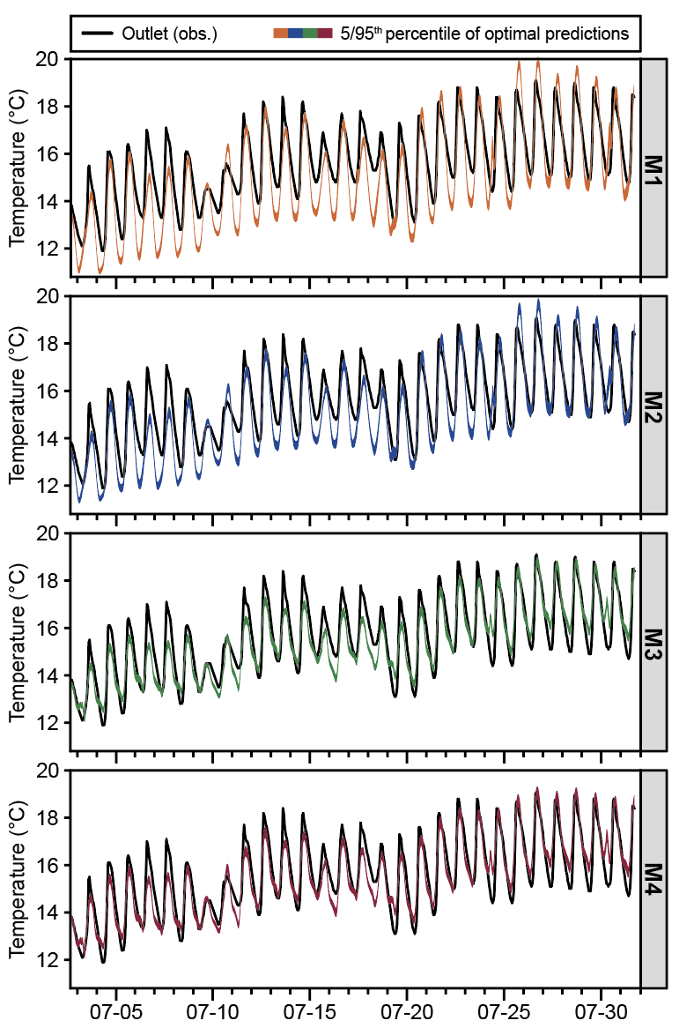
Assessing Ability of Model to Fit Low-Flow Temperatures
Headwater
Outlet
Best Runs
(RMSE)
H: 0.745ºC
O: 1.079ºC
Assuming top 1% of runs represent peak performance
H: 0.523ºC
O: 0.933ºC
Envelopes show 5th/95th confidence intervals of best runs
H: 0.559ºC
O: 0.645ºC
H: 0.650ºC
O: 0.612ºC
25
Notes:
Let’s take a look at the predicted temperatures for each model configuration we tested.
These figures show the 5th to 95th confidence envelopes of the top 1% of model runs. These envelopes bound the likely best performance of each configuration under peak-calibration
On the right, I also show the RMSE values of the best model runs for each configuration
As a reminder, model degrees of freedom increases from M1 to M4. M1/M2 don’t have hyporheic flow, M3/M4 do have hyporheic flow
Remember that M1 is the simplest model, then as we progress downward we gain additional parameters and processes
M1: Poor headwater fit, overestimating temperatures. Poor outlet fit, understanding temperatures.
M2: Adding groundwater flow tuning slightly improves performance, but still missing maxima and minima
M3: Adds 1 degree of freedom over M2, incorporating hyporheic flow. Greatly improved performance at both gages, with best runs down to around 0.6 C RMSE
M4: Most complex model with all tuned parameters, some increase in performance over M3 but visually difficult to distinguish

Slide 26
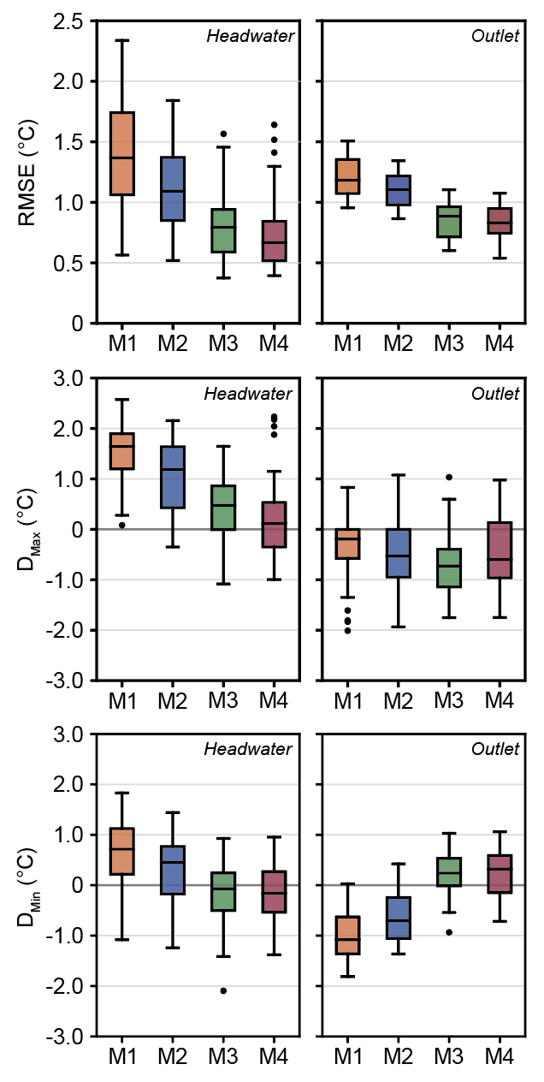
Trends in Model Performance Across Multiple Metrics
Progressive improvement in performance with additional calibrated parameters
Greatest decrease in error between M1/M2 (no hyporheic flow) and M3/M4 (hyporheic flow)
RMSE
Daily Maxima
Error
Daily Minima
Error
26
Notes:
We can also look at metrics outside of RMSE to assess other aspects of model performance
RMSE = overall behavior
Daily Maxima Error = how well do the modeled daily peaks match observed, this represents how well we’re representing radiative fluxes
Daily Minima Error = how well do the modeled daily minima match observed, this represents how well we’re representing hydrologic fluxes
Generally, we see progressive improvement in performance with the addition of calibrated parameters, which is not surprising
The greatest decrease in error occurred between M1/M2 (models without hyporheic flow) and M3/M4 (models with hyporheic flow)
M3/M4, the most parameterized models, achieved mean calibrated RMSE values below 1 C
If we look at daily maxima and daily minima error, we see a similar story, with more parameterized models having better performance
The notable exception to this is the daily maxima error at the outlet (middle panel), where more complex configurations didn’t drastically improve our representation of maxima
This could be because the parameters we tune are generally hydrologic in nature, and hydrologic controls tend to have less of an influence on daily maxima, which is a radiative controlled process

Slide 27
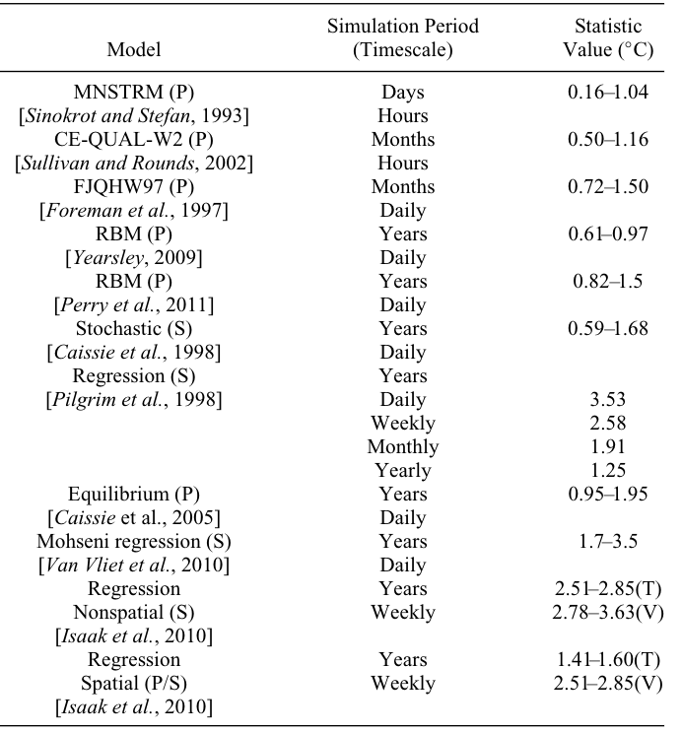
Model Performance In Context
RMSE < 2.0ºC is a recognized threshold for reasonable water temperature predictions (Yearsley, 2012).
All configurations capable of producing simulations with RMSEs under 2.0ºC at both gages.
Yearsley (2012)
27
Notes:
Thinking about how the model is performing in context:
An RMSE of 2 C is a generally recognized threshold for reasonable modeled water temperatures
The table on the left shows some model RMSE values for a range of temperatures, most range from 1-2 C
All the configurations we tested were capable of producing simulations with RMSEs under 2 C at both gages when well-calibrated
Best runs were considerable better than that 2 C threshold, suggesting that our model can recreate temperature behavior in this basin in this single month

Slide 28
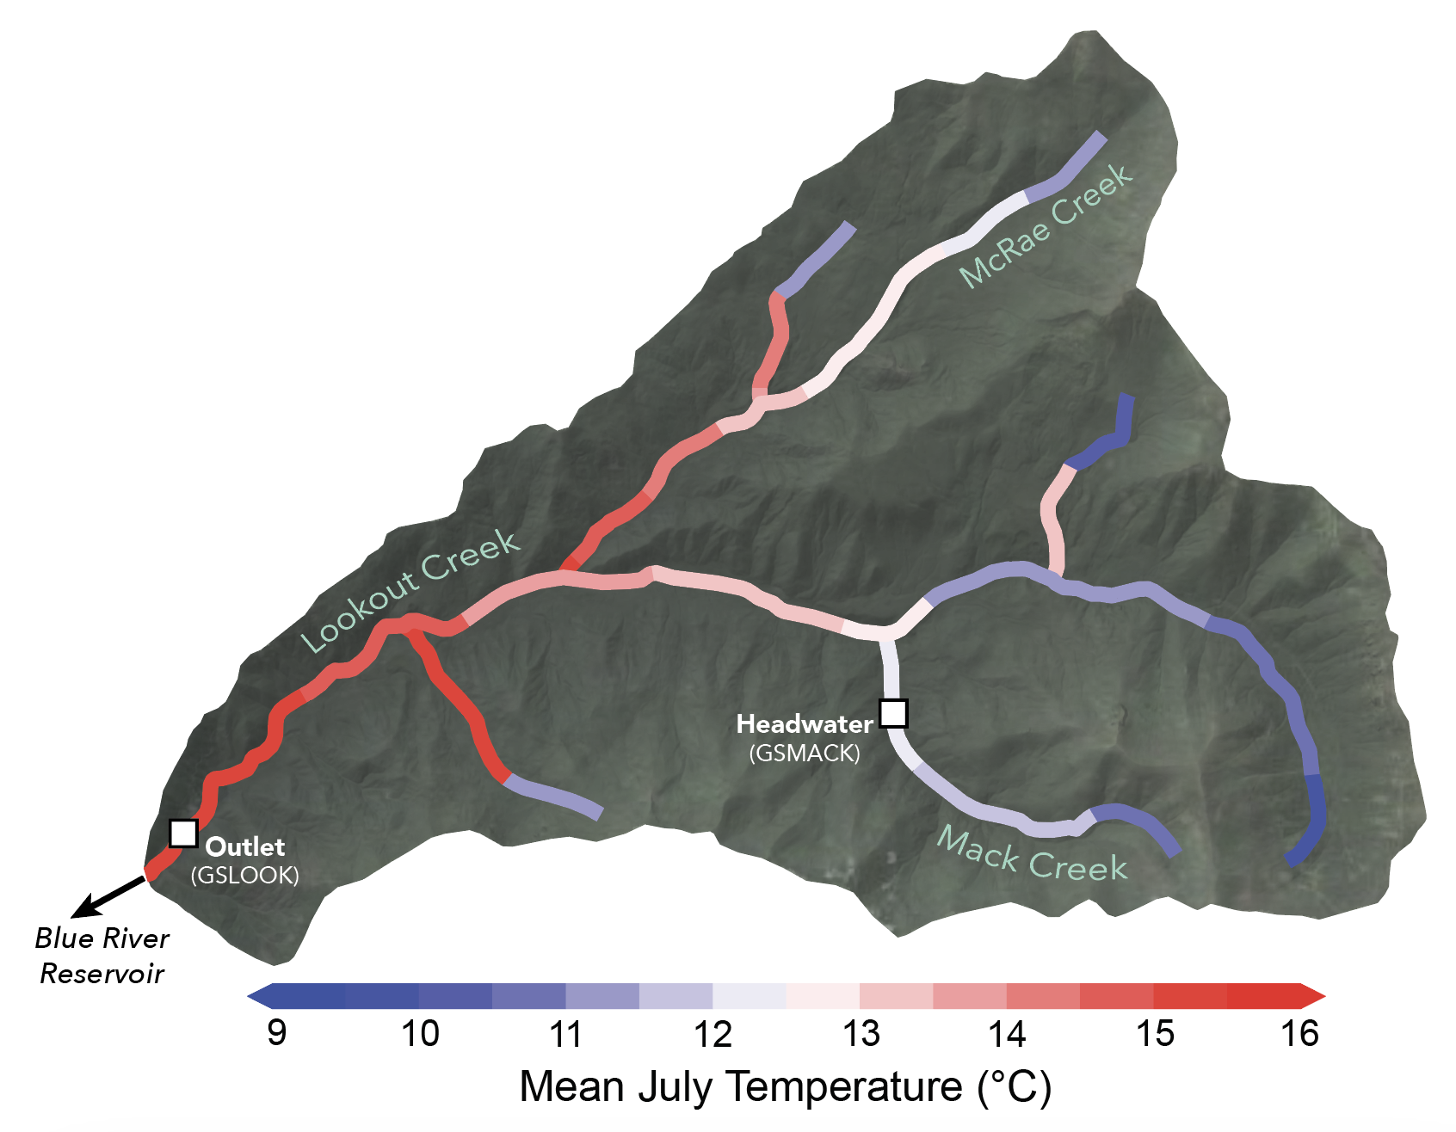
Beyond Point Temperatures: A Full Stream Network View
Our model captures general pattern of warming from headwaters to outlet.
Full network predictions are more actionable than simulations at single points.
Best M4 Run
28
Notes:
Looking at Mean July Temperatures across the network for the best calibrated run of M4 (most parameterized model)
This is the view we would have when looking at temperatures integrated into the operational NWM
From this high level view, we can see that the model generally captures the pattern of downstream warming, from cooler headwaters to warmer outlet temperatures
Being able to grasp the full network picture of water temperature variability gives considerably more insight into management than predictions of temperature at single points along the network.

Slide 29
Missing Heat Fluxes? Opposition between Headwater and Outlet
In simpler configurations, outlet is only fit well when headwater temperatures have warm bias
Missing downstream heat
In more parameterized configurations, addition of hyporheic flow reduces bias in headwaters
29
Notes:
Unfortunately, the model has some issues. There is evidence that we’re missing heat fluxes somewhere between the headwater and outlet gages.
In simpler configurations, in order to fit the outlet gage, the headwater temperatures had a very strong warm bias, indicating that some amount of heat is missing
In more parameterized configurations, this issue seems to be partially alleviated due to the inclusion of hyporheic flow
This suggests that the missing heat fluxes are likely at the water-bed interface (hyporheic flow, bed conduction) and are difficult to simulate properly in small headwater streams.
Still plenty of progress to be made

Slide 30
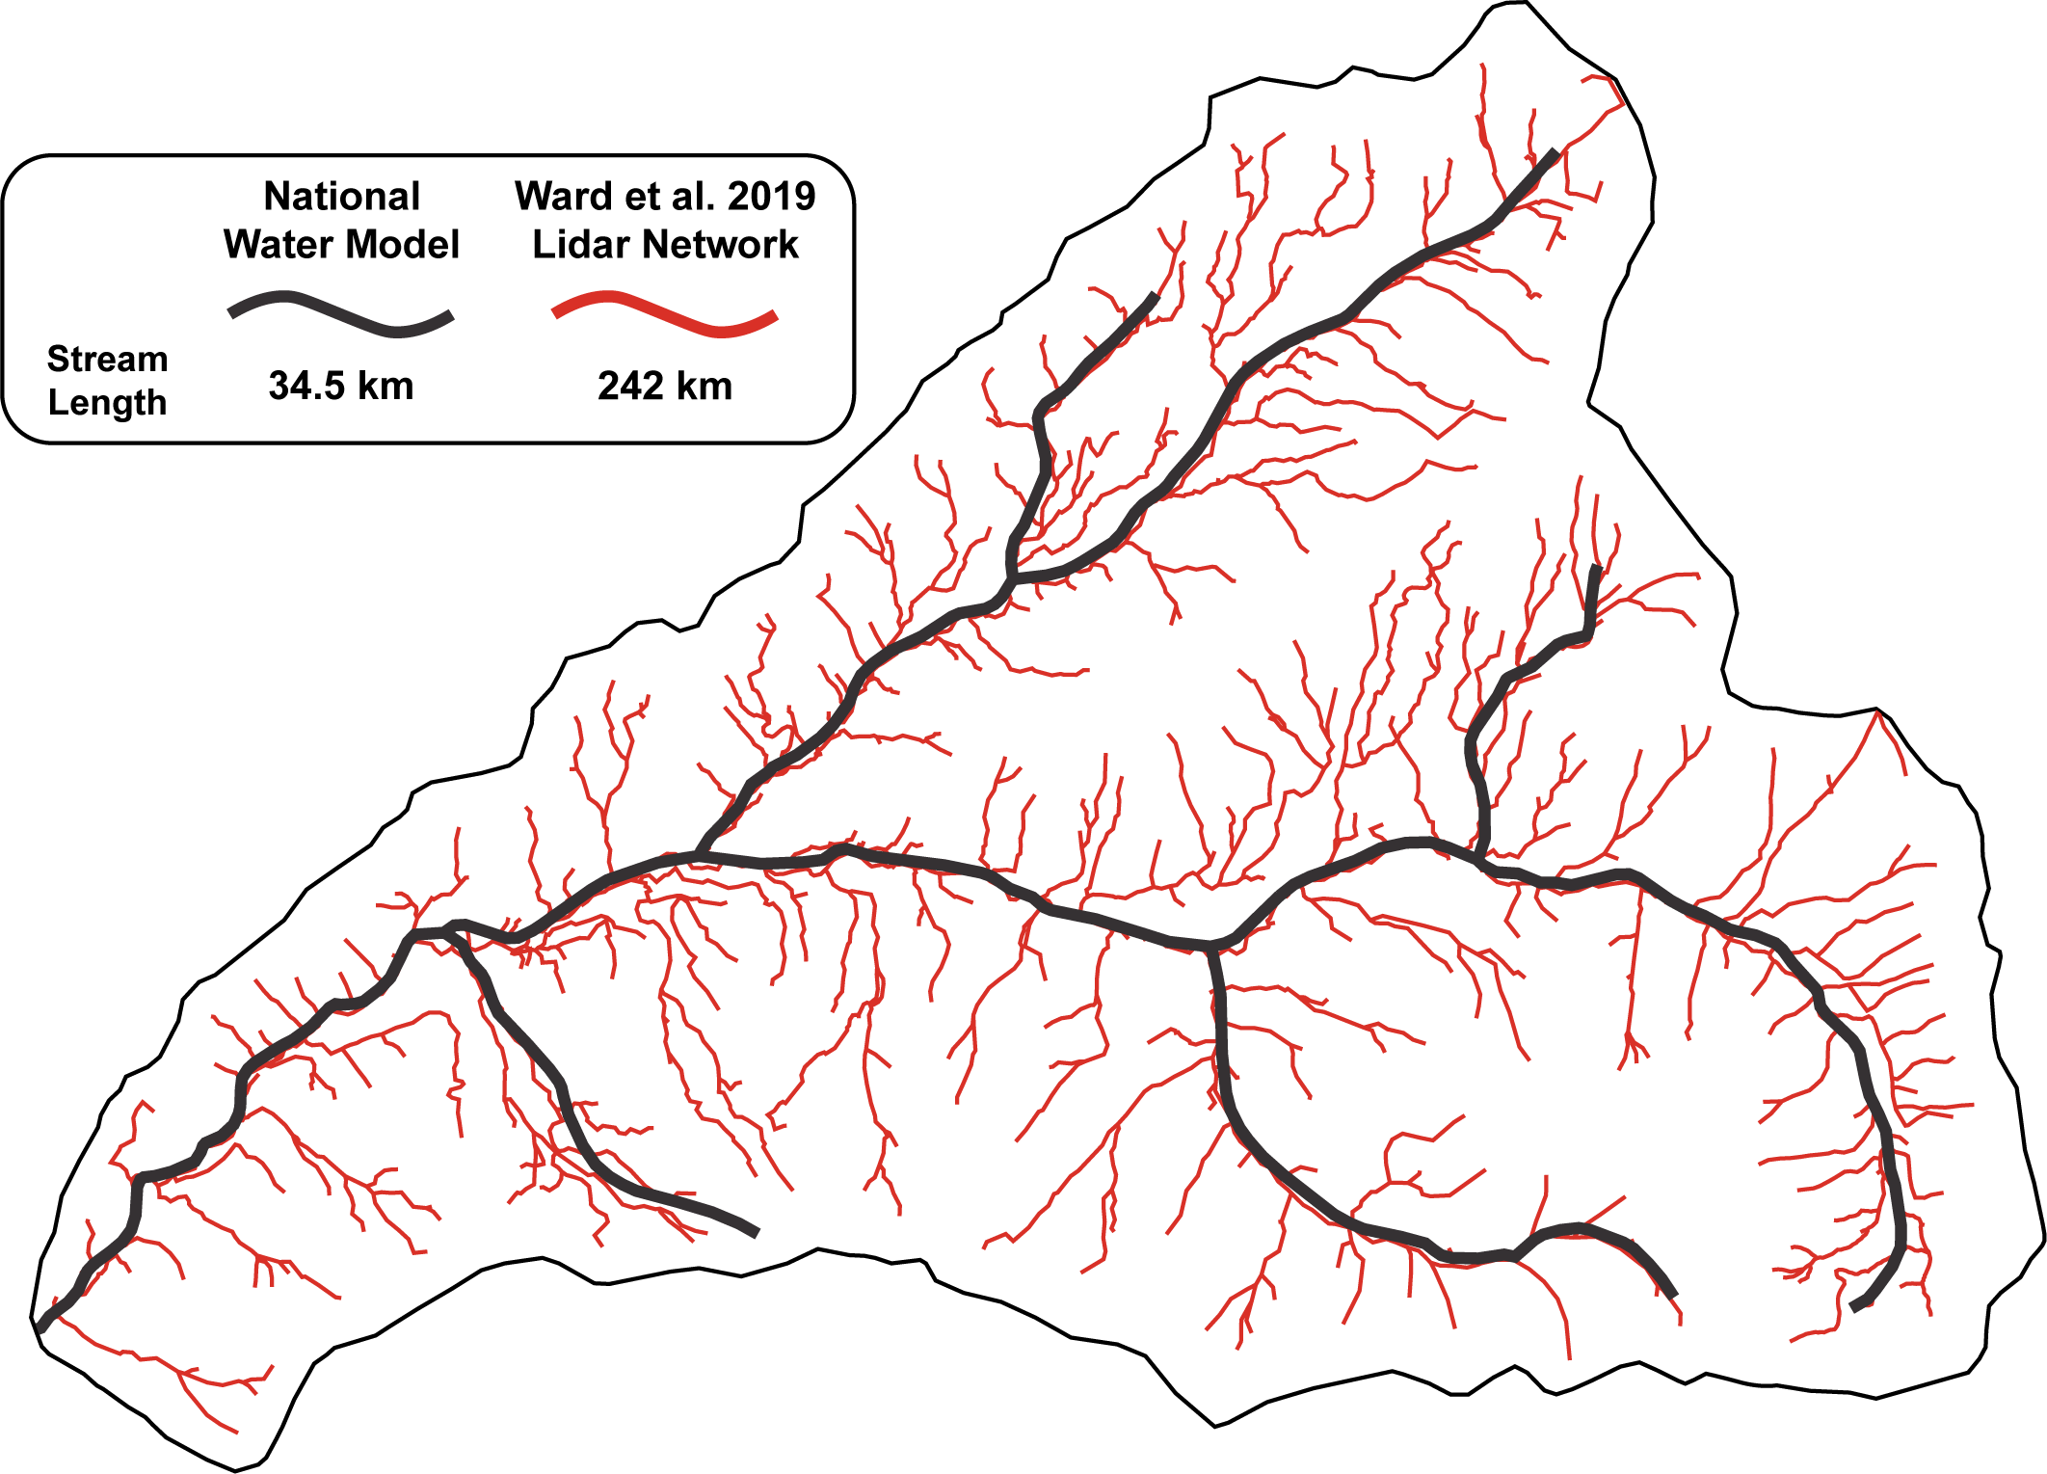
Challenges in Expanding from the Catchment to Continental Scale
NWM Uncertainty
Discharge is target variable for NWM optimization, not other states
Computational Limits
Is a physically-based model the right direction for WT?
Stream Network Simplification
Channel extent and its effect on WTs?
30
Notes:
Some open ended challenges in applying water temperature prediction to the NWM:
Obviously, computational limits are an issue. I don’t have an answer if this approach is computationally feasible for the entire continental domain
This raises the question: Is a physically based model the right direction for water temperature prediction in the NWM? Perhaps a machine learning, or hybrid approach could be better?
If we’re coupling temperature to the NWM, the uncertainty in temperature predictions are linked to uncertainty in NWM predictions
Our model relies on many model states of the NWM beyond just discharge. How confident are we in the model states of the NWM?
Another potential issue is that of the NWM’s simplification of the stream network
The NHD tends to underestimate the true extent of the stream network. In HJ Andrews, the NWM represents 200 km less stream length than on-site estimates
This could introduce potential biases in our predictions in headwaters if we’re missing time where water is exposed to radiation at the surface

Slide 31
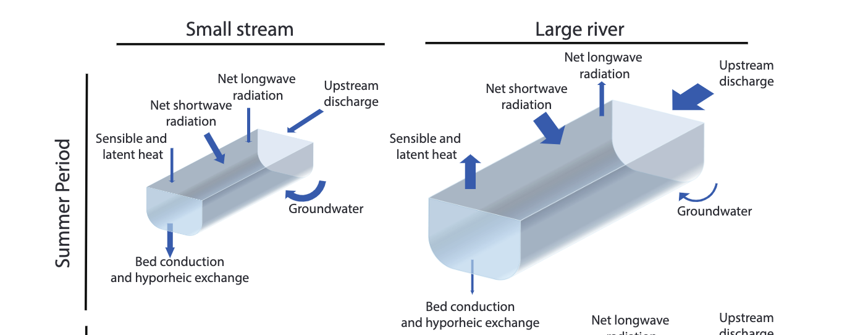
Evolution of Uncertainty Along the River Network
Headwater temperatures are more uncertain: streambed and hydrologic fluxes difficult to constrain
Larger streams are less uncertain: equilibrium with fluxes at the air-water interface and strongly controlled by radiation
Leach et al. (2023)
Leach et al. (2023)
Performance should improve down-network!
31
Notes:
One saving grace may be the fact that the temperatures of larger streams tend to be easier to model than that of headwater streams
In headwater streams, streambed and hydrologic fluxes make up a large proportion of the net heat flux, yet they are difficult to constrain
In larger streams, waters tend to be in equilibrium with fluxes at the air-water interface, and are strongly influenced by net radiation.
In general, net radiation tends to be easier to quantify in a physically based model
This means that the overall uncertainty in modeled temperatures should decrease down-network and require less tuning.
This also means that we could use simpler model configurations in larger rivers where temperatures are dominated by radiative heat fluxes

Slide 32
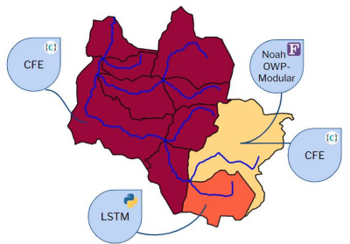
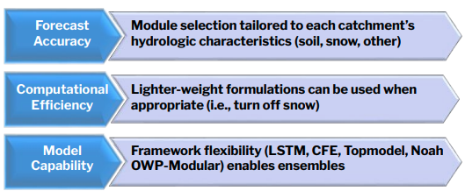
Moving into the Next Generation Modeling Framework
NextGen presents exciting opportunities for water temperature prediction
NOAA (Trey Flowers), 2022
Model formulations won’t work well everywhere - stream size, geographic contrasts
Flexible and interoperable models are the way forward!
32
Notes:
As we move into the Next Generation era of the National Water Model, I believe that NextGen presents exciting opportunities for water temperature prediction
We know that model formulations don’t work as well in all locations, some may be better suited for different geographic regions or types of rivers
NextGen will allow us to pick and choose from a suite of models, using the best performing model in different sub-catchments
This has benefits for computational efficiency and overall performance

Slide 33
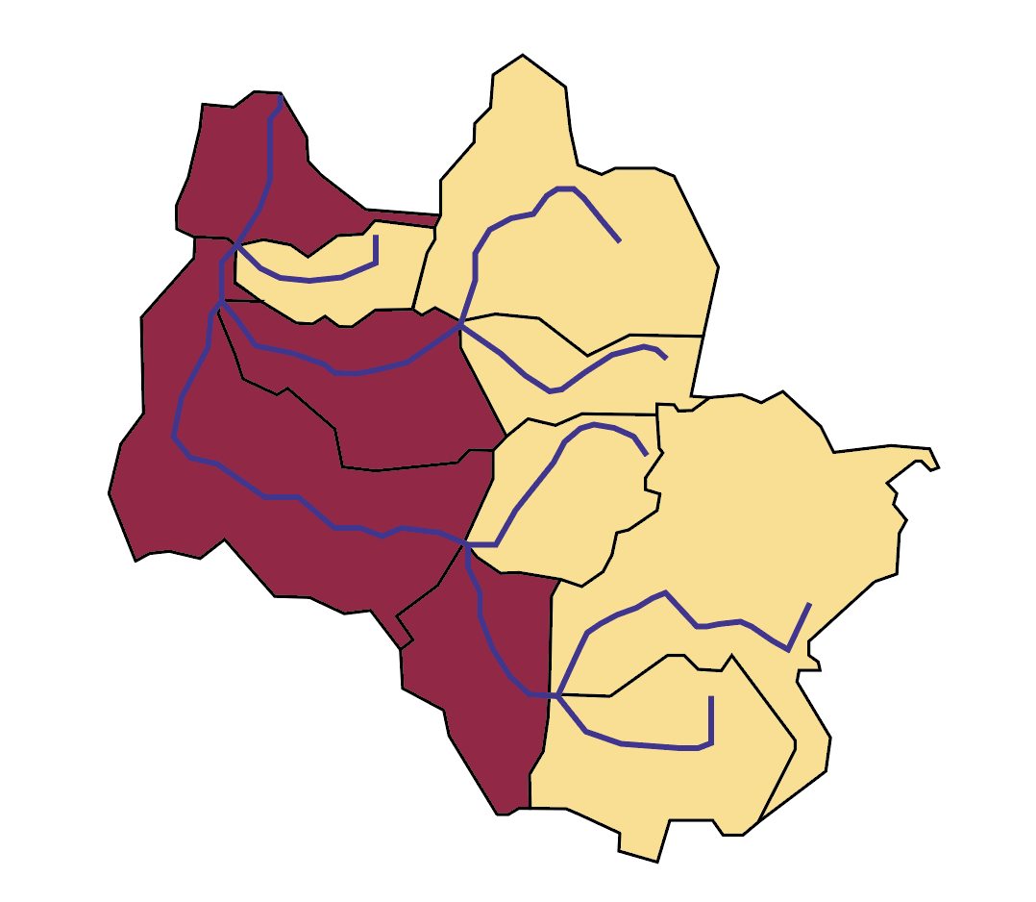
Water Temperature Prediction in the NextGen Framework
Simpler
radiation dominated configuration down-network
NOAA (Trey Flowers), 2022
Resolve complex controls in headwaters
33
Notes:
How can we incorporate our understanding of water temperature prediction into the NextGen framework?
We know that headwaters likely require more complex configurations resolving bed and hydrologic heat fluxes
In larger streams, we may be able to get away with using simpler models that rely on the controlling influence of incoming radiation
In the NextGen framework, we could leverage that understanding to assign certain model configurations to specific subcatchments
In the uplands of watersheds, we would use more complex and parameterized approaches
In higher order subcatchments, we would then use simpler configurations
This could reduce the overall computational load on the modeling system while achieving high performance across the stream network

Slide 34
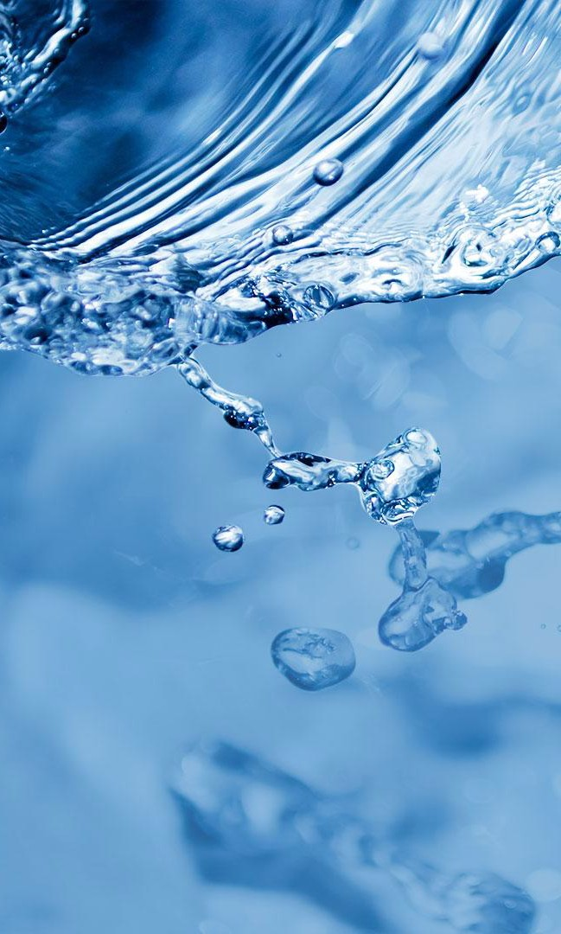



Primary Findings and Next Steps
With model calibration, hourly water temperatures can be predicted accurately using forcings/outputs from the NWM
New strategies needed to estimate uncertain inputs at broader spatial scales
Further development should focus on incorporating water temperature model configurations into the NextGen framework
github.com/jswade
jswade@syr.edu
Jeffrey Wade
34
Notes:
Concluding words on our findings:
With calibration, the NWM can be used to predict hourly temperatures with high degrees of accuracy, at least within a single basin and time period
If we are going to scale this up, new strategies are needed to estimate uncertain inputs
Further development should take advantage of the unique opportunities that the NextGen framework has to offer

Slide 35
My Future Plans
This work will make up Chapter 3 of my dissertation, which I am defending at the beginning of April.
Submit my dissertation chapter for publication (targeting Environmental Modeling and Software).
Model code will be on GitHub within the month.
On the job market: Looking for agency or agency consulting science positions (direct hire eligible).
35

Slide 36
Primary Findings and Next Steps
With model calibration, hourly water temperatures can be predicted accurately using forcings/outputs from the NWM
New strategies needed to estimate uncertain inputs at broader spatial scales
Further development should focus on incorporating water temperature model configurations into the NextGen framework
github.com/jswade
jswade@syr.edu
Jeffrey Wade
36
Notes:
Concluding words on our findings:
With calibration, the NWM can be used to predict hourly temperatures with high degrees of accuracy, at least within a single basin and time period
If we are going to scale this up, new strategies are needed to estimate uncertain inputs
Further development should take advantage of the unique opportunities that the NextGen framework has to offer

Slide 37
Extra Slides

Slide 38
Water Temperature Modeling: Challenges
Temperature Predictions Unique to Reaches, Nationwide
Moving Beyond Daily Values to Real-Time Temperatures
Lack of Water Temperature Observations Makes Model Validation Challenging
10
Notes:
There are a few general challenges facing water temperature prediction currently.
Completing priorities of scale vs. resolution
Plenty of high resolution water temperature models, but generally confined to a single basin
Select few models predict water temperatures nationwide or globally, but predictions are typically gridded and don’t correspond to specific reaches
How can we mesh high resolution models in space and time with models that cover a broad spatial extent
Moving beyond summary statistics
Many models (primarily statistical models) generate mean daily predictions at single points rather than distributed real-time temperatures
Real-time, continuous predictions give more insight into management
Compared to observations of discharge, water temperatures are notably more sparse
Could make assessment of model performance at broad scales difficult
Lack of gages in headwaters could introduce bias in assessment locations
NWM can overcome the first two, last one will be a longstanding challenge

Slide 39
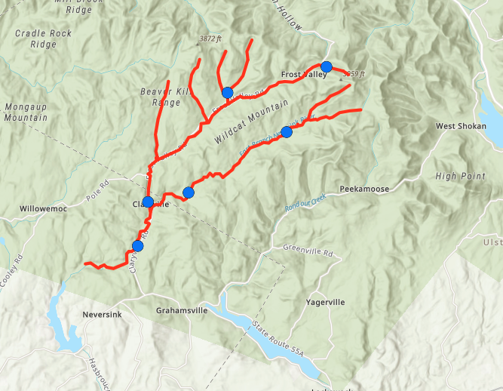
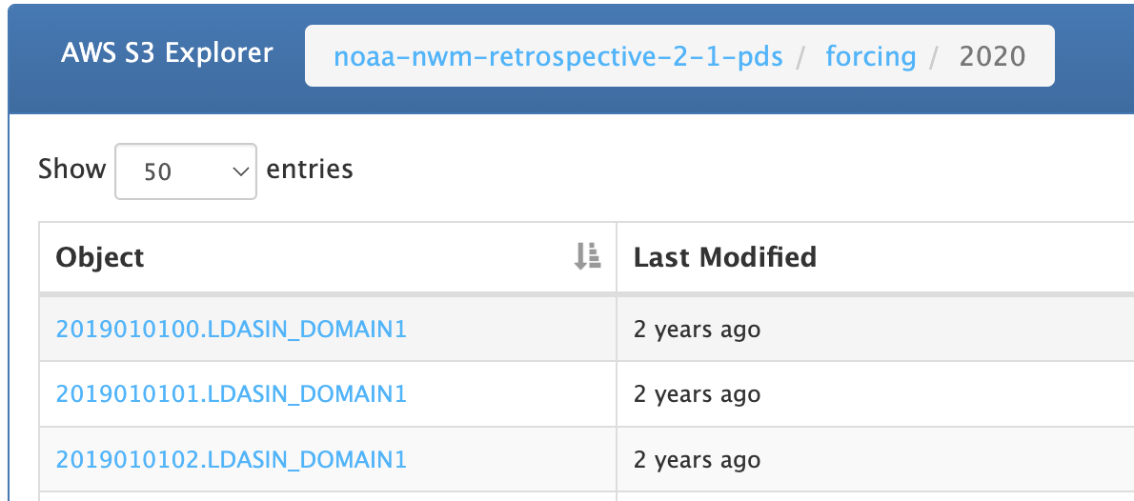
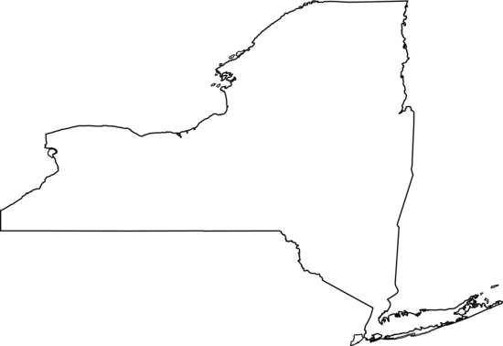
Round 1: Neversink River, Catskill Mountains, NY
66 km² catchment with 6 recently installed USGS temperature gages
But…errors in AWS repository made it challenging to align with observed temperatures at site
0
4
8
km
14
Notes:
In developing a WT model – a test basin is needed, not practical to run model on continental-scale domains
I considered several test basins: criteria: limited number of tributaries (straightforward to model), as many USGS temperature gages as possible, particularly in headwaters (enables model evaluation)
Originally identified a catchment in the Catskill Mountains with 6 USGS temperature gages.
Unfortunate, due to errors in the AWS retrospective in 2020 (the only year when NWM data overlapped with observations), I had to
Neversink River – headwater catchment in the Catskill Mountains of southeastern New York, flowing into the Delaware River. West Branch drains from Slide Mountain, the Catskills tallest mountain
This basin has a drainage area of 66 km2, is made up of 32 NHD (National Hydrography Dataset) reaches, and has 6 (!!) USGS temperature gages

Slide 40
Choosing a Model Frame of Reference
Eulerian
Lagrangian
Semi-Lagrangian
2
1
Easy to implement
Courant condition
Restrictions on space and time steps
Computationally-intensive
Not well suited to time-variable discharge
No Courant condition
Reasonable computation speeds
Supports time-variable discharge
No Courant condition
23
Notes:
Let’s get into the details of model development
First step in building a model is to choose a frame of reference: how do we want to represent the river reach in computational space
Eulerian/Lagrangian are two perspectives for viewing fluid flow (relevant for computational fluid dynamics)
Eulerian – Fixed mesh, we watch the fluid pass through a grid of points, calculating temperatures at each model point
Easy to implement, limited by Courant Condition (restrictions on space-time steps)
Lagrangian – Mesh-free, frame of reference follows water parcels downstream and integrates inputs with distance/time
Computationally-intensive, not well suited to changes in discharge with time, not limited by Courant Condition
Semi-Lagrangian – combination of frames of references, begin with Euler grid, track water parcel upstream to starting location, integrate inputs as it travels downstream
Not subject to the Courant condition, stable across time scales of 1-minute to multiple hours, reasonable computation times, flexible
Originally began with an Eulerian approach, but model stability conditions restricted the model to either small time steps or small spatial steps, neither of which are suited to continental-scale modeling
Eventually settled on a Semi-Lagrangian approach that was both computationally efficient and allowed flexibility in space/time steps

Slide 41
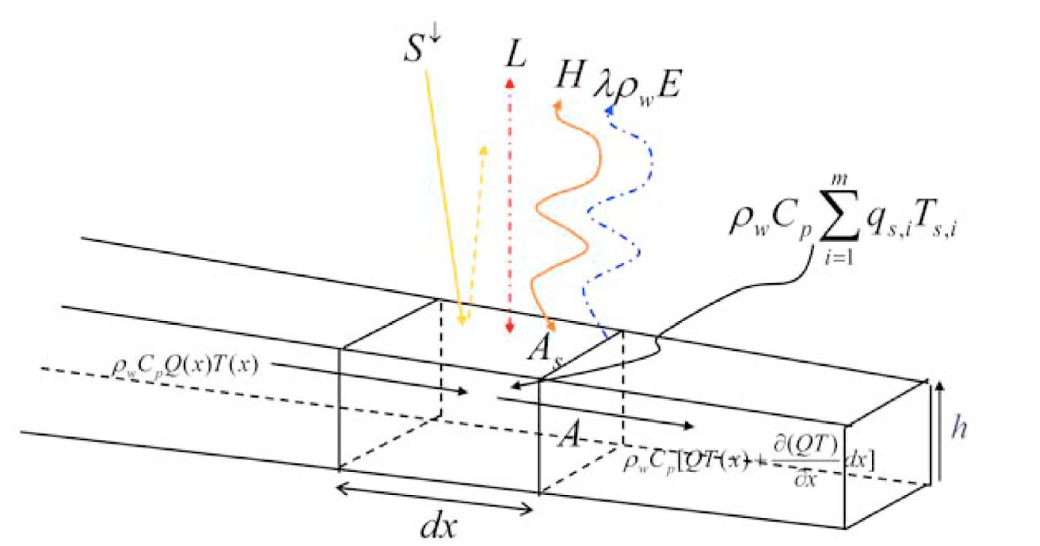
Radiative and Hydrologic Heat Budget
NWM Forcings
NWM Outputs
Air-Water Fluxes
Hydrologic Fluxes
Shortwave
Groundwater
Longwave
Surface Runoff
Sensible
Van Beek et al., 2012
Tributaries
Latent
12
Notes:
Getting into the details of water temperature: How do we model water temperatures?
Physics-based models typically rely on an energy balance approach.
1 dimensional advection model: heat is transported longitudinally along the stream, and heated or cooled by atmospheric and hydrologic heat fluxes
Atmospheric Fluxes: (variables we need are in NWM forcing files) – inputs like air temperature, humidity, windspeed
SW = Solar Radiation
Longwave = low energy emitted by clouds/landcover/water
Sensible Heat = energy exchange across air-water interface (differences in temperature)
Latent Heat = energy transferred through evaporation
Hydrologic Fluxes: (variables we need are in NWM channel output files) – inputs like discharge, water volume, GW inflow

Slide 42
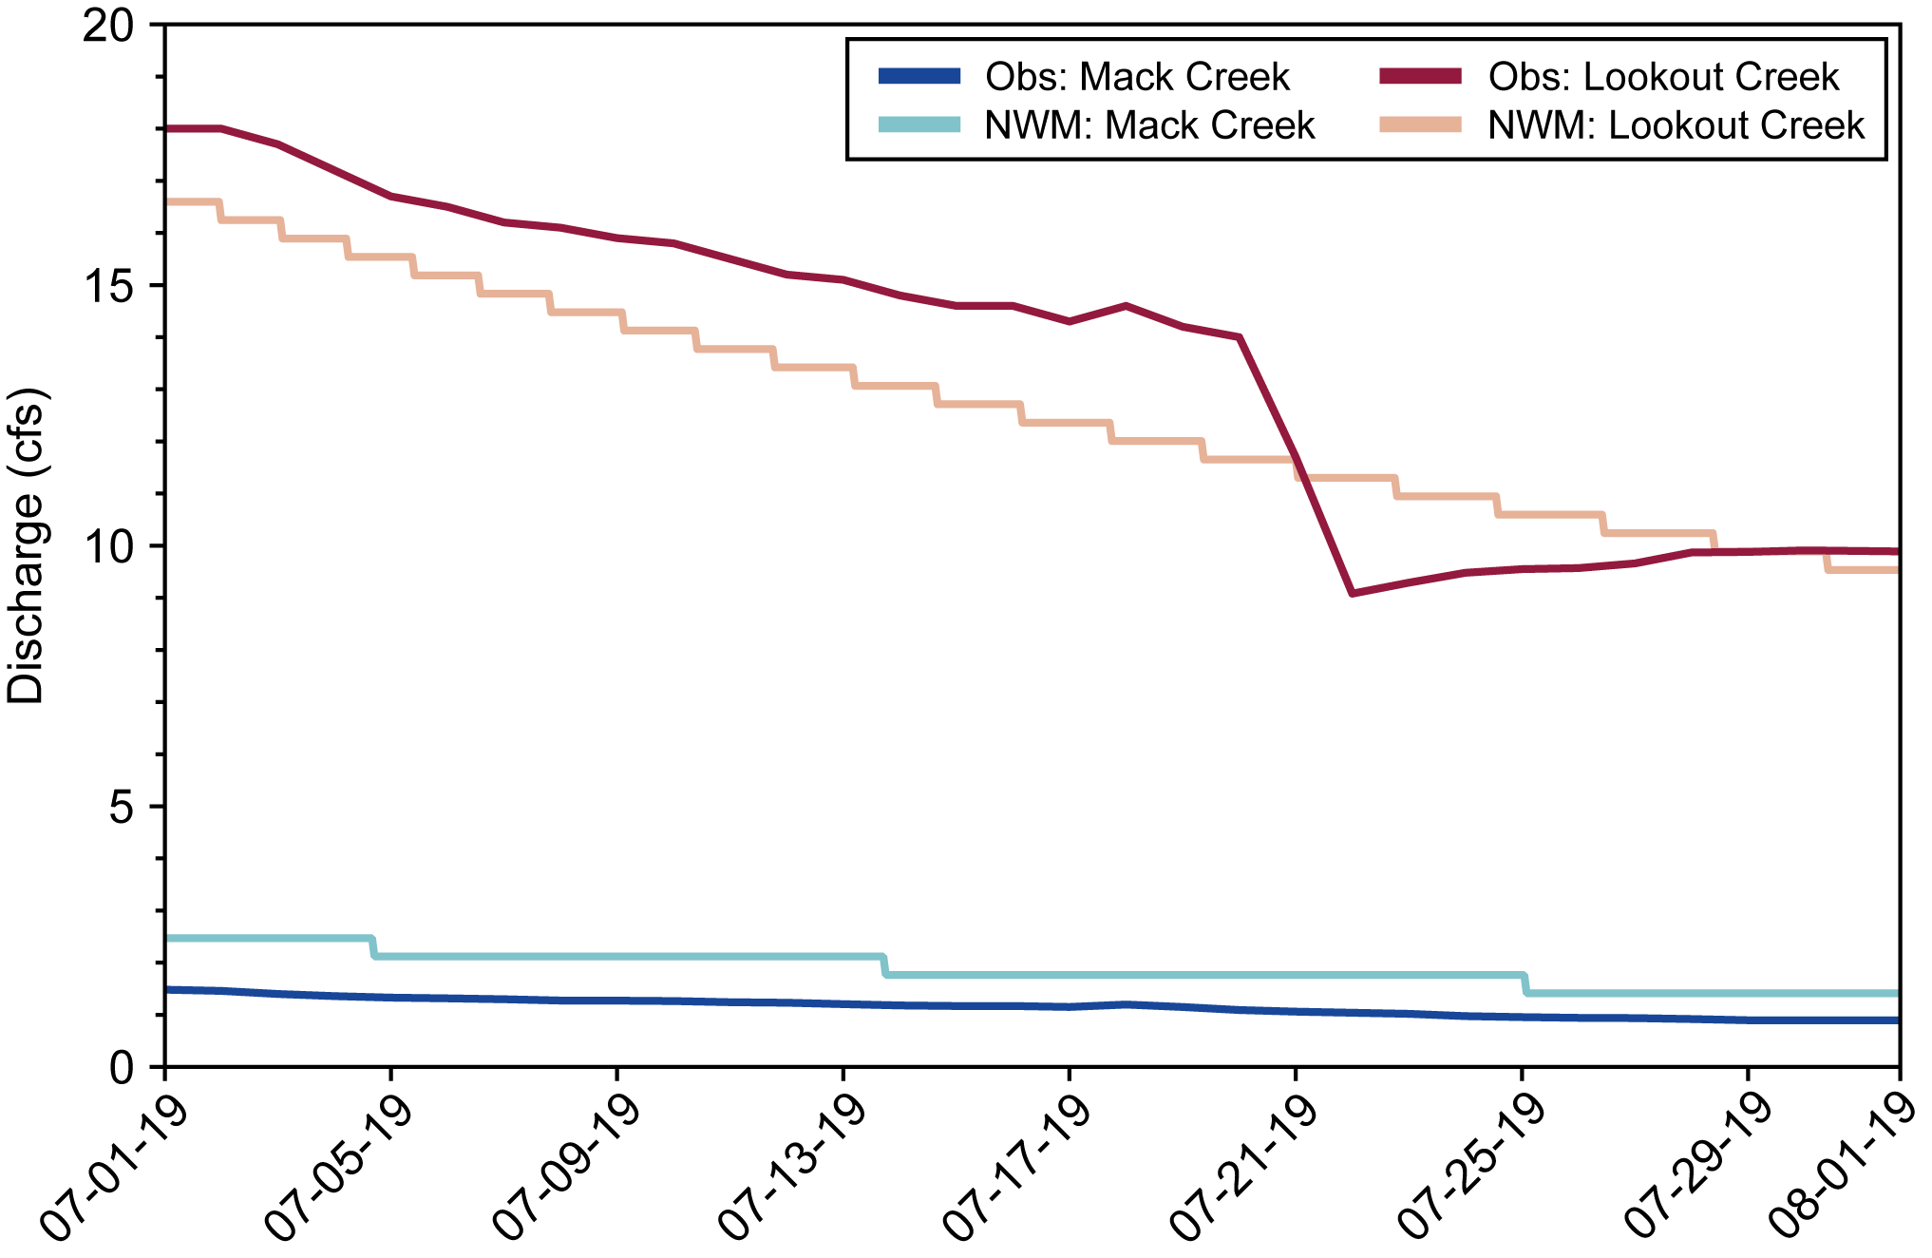
Evaluating NWM Predictions of Discharge
18

Slide 43
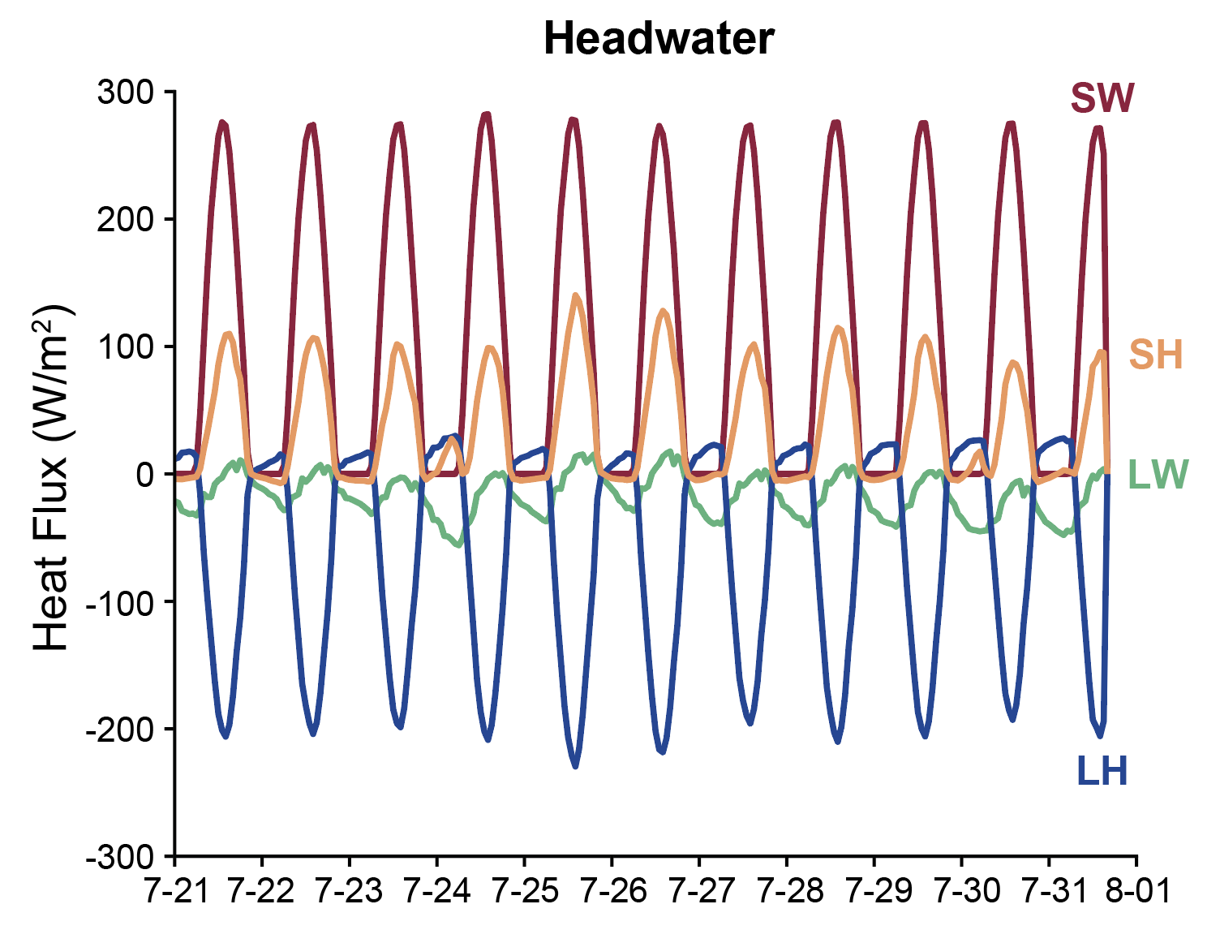
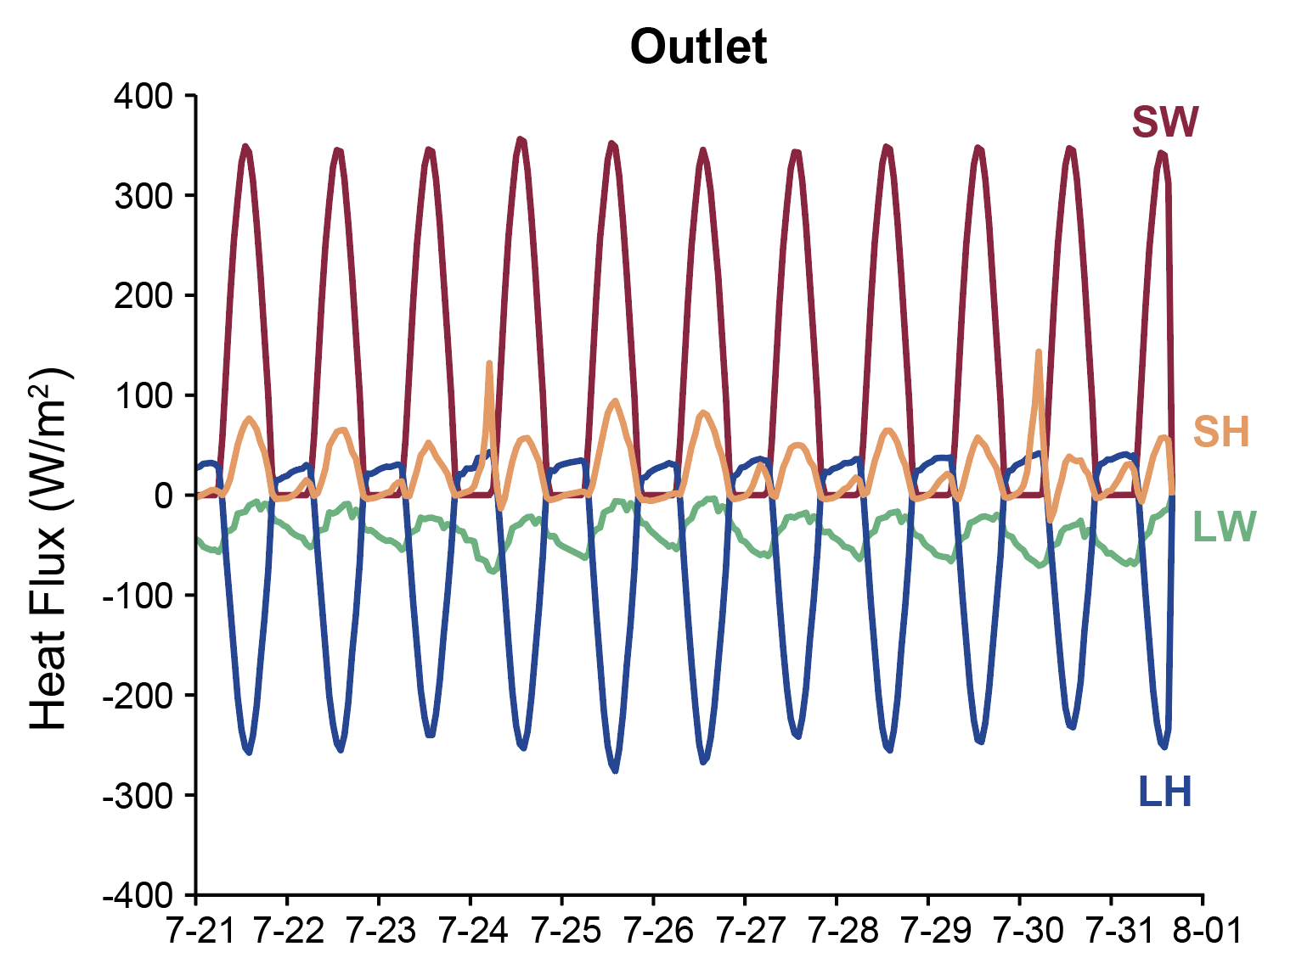
A Quick Look at Heat Fluxes
13

Slide 44
Reflecting on Strategies to Fill Data Gaps
Groundwater Temperature
Critical for simulating headwater temperatures
More efficient approach needed to estimate groundwater temperatures at broad scales
35
Notes:
Quickly reflecting the strategies we used to fill the missing data gaps:
The first of these is our approach to derive groundwater inflow temperatures from air temperatures
The temperature of inflows is vital, particularly in headwater reaches where it’s used to set the temperature of streamflow initiation
Our strategy seemed to work well in this basin in summer and generally fit headwater temperatures well
However, this approach wouldn’t be effective during winter months in regions with snow/ice cover
The tuning approach may be too cumbersome to apply at broader scales, a more efficient solution may be needed

Slide 45
Reflecting on Strategies to Fill Data Gaps
Groundwater Temperature
Hyporheic Exchange
Critical for simulating headwater temperatures
More efficient approach needed to estimate groundwater temperatures at broad scales
Accounts for missing downstream heat fluxes in M3/M4
Could be compensating for missing bed conduction fluxes (similar time lag)
36
Notes:
The inclusion of a conceptual hyporheic zone helped to account for missing heat fluxes in M3/M4, greatly improving model performance
Including hyporheic flow will only be necessary in headwater reaches that aren’t strongly influenced by radiation.
In larger rivers, its influence could probably be disregarded
I should also note that it’s difficult to tell if the importance of hyporheic exchange in our models actually represents hyporheic processes, or if it is instead compensating for other missing bed fluxes
Bed conduction has a similar time lag, so our conceptual hyporheic zone could be getting tuned to account for hyporheic flow and bed conduction simultaneously

Slide 46
Reflecting on Strategies to Fill Data Gaps
Groundwater Temperature
Hyporheic Exchange
Riparian Shading
Critical for simulating headwater temperatures
More efficient approach needed to estimate groundwater temperatures at broad scales
Accounts for missing downstream heat fluxes in M3/M4
Could be compensating for missing bed conduction fluxes (similar time lag)
Poor maxima fit could be due to riparian shading errors
Computationally efficient method needed to characterize shading along all river reaches
37
Notes:
Riparian shading approach generally seemed to work well in this heavily forested basin
Some of the maxima error in our models may be attributable to errors in representing shading
This approach may be feasible at broader scales, but perhaps there are better datasets than the US Forest Service gridded products for this approach
May need to think of other strategies for regions where shading is not caused by tree canopy (streambank grasses, etc)

Slide 47
Calibrated Parameters for Top 1% of Runs
Parameter | M1 | M2 | M3 | M4
C¹_{AT-GW} | 0.633 | 0.563 | 0.261 | 0.269
C²_{AT-GW} | 0.828 | 0.837 | 0.487 | 0.554
C³_{AT-GW} | 0.640 | 0.745 | 0.525 | 0.589
W | 7.200 | 7.220 | 7.880 | 7.420
R_{shade} | 0.999 | 1.042 | 0.690 | 0.699
GW¹ | - | 1.141 | - | 1.262
GW² | - | 1.433 | - | 1.325
GW³ | - | 1.339 | - | 1.279
H_{lag} | - | - | 11.380 | 11.740
H¹_{frac} | - | - | 0.666 | 0.682
H²_{frac} | - | - | 0.478 | 0.469
H³_{frac} | - | - | 0.175 | 0.142
13

Slide 48

State of the Science: Wanders et al. 2019
DynWat: Global WT Model
Global daily water temperature predictions based on PCR-GLOBWB 2 (Sutanudjaja et al., 2018)
Gridded 10 km resolution
Median RMSE of 3.2ºC
OWP Strategic Plan 2021-2026
Wanders et al. (2019): Annual Mean WT 1960–2014
9
Notes:
Not forward-looking forecast capable, predictions not linked to specific river reaches (gridded)

Slide 49




Decision Support Applications: Salmonid Health
Trout Outcomes based on Maximum WTs
Optimal
Warm
High
Pair spatially-distributed temperature forecasts with ecosystem knowledge to inform
management decisions
Recommendation: Limit fishing pressure in lower reaches
18
Notes:
A spatially and temporally continuous water temperature model gives exciting opportunities for decision support, particularly in fisheries management
Currently, we only know temperature at a relatively small number of points in the US, and typically can’t resolve spatial patterns in time
By pairing temperature forecasts with ecosystem knowledge, we can better inform decisions related to ecosystem management.
For example, the health of trout and salmon species are closely linked to maximum water temperatures, with temperature thresholds linked to negative health outcomes
If we pair these biological thresholds with our spatially-distributed temperature forecasts, a model such as this one could provide decision guidance
We could run a water temperature forecast for a given river reach, filter simulations by trout threshold temperatures, and inform fishing closures to preserve fishery health based on maximum temperatures in space

Slide 50



Excluded Processes from Water Temperature Model
River Ice Dynamics
Power Plant Effluent
Dams and Reservoirs
USGS
USGS
USGS
13

Slide 51



Thank You!
Jeffrey Wade
jswade@syr.edu

